Slide 1
Katherine A. Kendall Institute for International Social Work 2019 KAKI Grant RFP
Informational Webinar
February 25, 2019

Slide 2
Agenda
Panelist Introductions
Review RFP by section
Question & Answer

Slide 3
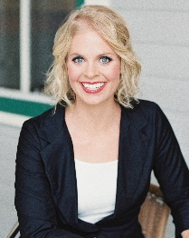
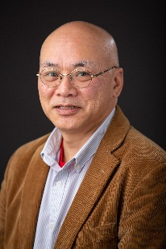
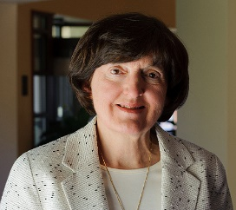
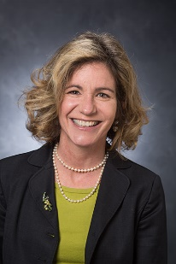
Introductions
Katherine Lord, CSWE Program Associate
Grants Administrator
Peter Szto, Professor of Social Work, University of Nebraska at Omaha
KAKI Advisory Board Member, Grants Sub-Committee
Lynne Healy, Professor Emeritus, University of Connecticut
KAKI Advisory Board Chair
Jane McPherson, Director of Global Engagement & Assistant Professor, University of Georgia
2017 KAKI Grant Recipient

Slide 4
Request for Proposals
Overview
This is a 2019 grant cycle request for proposals (RFP) for the Katherine A. Kendall Institute for International Social Work (KAKI).
The KAKI Grant Program facilitates the development of international social work education materials and curricula by helping educators create tools that bring the global context into social work classrooms in the United States. These projects leverage creativity and innovation with existing knowledge and practice to influence the future of international social work education nationwide.
The 2019 grant cycle spans 3 years, July 1, 2019, to June 31, 2022. KAKI will award at least three grantees up to $10,000 each in this cycle.
Outcomes
The outcomes from the KAKI grant projects will be creative, timely, transferable, and sustainable educational materials that support bringing the global context into social work classrooms in the United States. The completed project deliverables, shared with the CSWE membership via the KAKI website, serve as replicable and sustainable teaching resources that educators can use in their own institutions.

Slide 5
Cohort Format
To provide peer support, share expertise, and foster an opportunity for networking, the 2019 KAKI grantees will participate in a cohort model. Grantees will join a cohort Zoom call in each year of the grant cycle and virtually present their final projects to one another and the CSWE staff. Additionally, the current cohort and previous KAKI grant recipients will have the opportunity to meet at the CSWE Annual Program Meeting at the KAKI Partnership Session. A selection of grantees will report on their work and offer insights about their projects and process.
2019
Cohort
Touchpoints with fellow grantees & grant administrator
Yearly Zoom Call
APM Session & Networking
Interactive Presentations

Slide 6
Eligibility
CSWE Members, including Program members in candidacy
One member must be a CSWE member throughout the duration of the grant
May include collaboration with community partners or organizations
Exclusion Criteria
KAKI will not consider funding for:
Overhead costs;
Projects for which the primary purpose is travel;
Exclusively research-based projects; or
Projects without tangible, transferable deliverables

Slide 7
Evaluation & Selection
Evaluation
Selection
Grant proposals will be evaluated based on adherence to application criteria, project focus, scope, innovation, and budget to support the project.
Proposals will be reviewed and selected by an internal CSWE team and the KAKI Advisory Board. Reviews will be guided by a grading rubric based on the proposal criteria and the respective missions of KAKI and CSWE. During the review process, applicants may be asked to clarify and elaborate on their proposals.

Slide 8
Continuous Review
Touchpoints
- Cohort Zoom Call
- Meeting with Grant Administrator
Progress Report
- 1 report submitted for 2nd installment of funding
- Reporting Template
Final Presentation
- Virtual presentation to CSWE staff
- Opportunity for presentation at APM
Notes:
- Discuss having resources on CSWE website

Slide 9
Changes to the Project
If any changes are made to the original proposal due to deliberate or unforeseen circumstances, the program associate must be informed immediately to determine whether the new scope of work is approved for the remainder of the grant.

Slide 10
Timeline
RFP released | February 19, 2019
Informational webinar | February 25, 2019
Proposals due to CSWE | April 19, 2019
Awardees notified | June 17, 2019
Funds disseminated to awardees | July 1, 2019
Implementation of grant project | July 2019
Y1 Cohort Zoom call | Fall 2019
Y1 Individual grantee meeting with program associate | TBD*
Y2 Cohort Zoom call | Fall 2020
Y2 Individual grantee meeting with program associate | TBD*
Progress report submitted | TBD*
Second installment of grant funds released | After review of progress report
Y3 Cohort Zoom call | Fall 2021
Y3 Individual grantee meeting with program associate | TBD*
Final project submitted and presentation to 2019 Cohort and CSWE staff | by June 30, 2022
*Specific date proposed by applicant and scheduled with program associate

Slide 11
Submission
Submit application through FluidReview: https://cswe.fluidreview.com/.
Applicants must complete all sections of application noted in FluidReview.
Project budget must be included in an Excel document attached in the appropriate section of the FluidReview application.
Submissions are due no later than April 19, 2019, at 5:00 pm EDT. Submissions received after this time or not in compliance with the standards outlined above will not be reviewed for submission.

Slide 12
Project Prompts
How does this project bring the global context into the classroom in the United States?
How many students am I reaching with this project? How could I reach more?
How could other social work educators replicate this project in their own institutions?
What lasting impact will this project have on international social work education?
How does this advance the field of international social work education?
Proposals that internationalize essential elements of the social work curriculum, including human behavior and the social environment, social policy, research, and social work practice, are encouraged. Other topics for grant projects may include human rights, social and economic justice, environmental justice, immigration, migration, climate change, globalization, colonialism, public health, or other suitable issues.

Slide 13
Proposal Contents
Project Abstract (500 words max)
The abstract should present a clear and concise summary of the project. It should include the need for the project, the population it will serve, goals and objectives, and the applicant’s professional background and qualifications. Make sure you include the amount of funding that is being sought and how the project will be evaluated to measure its success.
Statement of Need (500 words max)
The statement of need should clearly describe the problem the project addresses, the population it will serve, and how the project will advance international social work education by bringing the global context into the American classroom.
Project Description (1,000 words max)
Describe the project in detail using standard research and project procedures (planning and analysis, design, development, implementation, evaluation). Include specifics on what will be accomplished, evaluation measures, and expected outcomes. Explain how the project will advance international social work education for American students and how it will bring the global context into the American classroom.

Slide 14
Project Contents Continued
Goals and Objectives (500 words max)
Outline project goals and objectives in relation to targeted outcomes. Indicate how goals and objectives will advance international social work education for American students. Include information on future use of the project deliverables and measures.
Transferability & Sustainability (500 words max)
Describe plans for how the project can be used by other institutions. Discuss how this project can be adapted for different contexts over time.
Timeline (500 words max)
Provide a detailed timeline of the project, including when the project funds will used.
Include the required in-person meetings with the CSWE program associate (see Continuous Review section).
Budget (1 page)
Itemize all expenses for your project. Provide specifics about how funds will enhance or support your tasks and objectives.

Slide 15
Notes on Budget
Travel funds: KAKI will not fund projects for which the primary focus is travel. If travel costs are included in your budget, they must be kept to a minimum and applicants must provide a detailed description of why the travel is critical to the project.
Additional funding sources: KAKI will consider funding projects that include funding from other sources, such as community partners or organizations. Please include a description of any additional funding or matching sources in this section.
Explanation is CRITICAL. Justify the purpose of each line item.

Slide 16
Questions/Comments/Contact
Katherine Lord, Program Associate & Grant Administrator
Email: klord@cswe.org
Office Phone: 703.519.2047
KAKI Grants Website: https://www.cswe.org/Centers-Initiatives/Centers/International-KAKI/Programs-and-Projects/Grants
2019 RFP: https://www.cswe.org/CSWE/media/OtherFiles/2019-KAKI-RFP_FINAL.pdf

