Slide 1
Addressing Stigma Concerning Substance Misuse
Dr. Audrey Begun, MSW, PhD
The Ohio State University
December, 2020
*Funded in part by the Substance Abuse and Mental Health Services Administration
Notes:
Welcome to this presentation concerning how social workers might recognize and address stigma related to substance misuse and how this issue relates to recovery. It is an important topic for everyone who cares about addressing substance misuse and supporting recovery.

Slide 2
Acknowledgements
This presentation is part of a 2019 grant awarded to CSWE from the Substance Abuse and Mental Health Services Administration to expand substance use disorder (SUD) practitioner education in social work. During the 2-year project, Expansion of Practitioner Education (Prac-Ed), CSWE will implement a high-quality standardized SUD curriculum, which will strengthen the preparation of future social work practitioners to deliver effective, evidence-based SUD prevention, treatment, and recovery services.
Notes:
Developing this presentation was one commitment in the 2019 Expansion of Practitioner Education grant awarded to CSWE from the Substance Abuse and Mental Health Services Administration. During the 2-year project, CSWE is implementing a high-quality standardized substance use disorder curriculum to strengthen preparation of future social work practitioners to deliver effective, evidence-based substance use disorder prevention, treatment, and recovery services.
So, let’s get started…

Slide 3
junkie
Notes:
[Read and pause]

Slide 4
stoner
Notes:
[Read and pause]

Slide 5
pothead
crackhead
Notes:
[Read and pause]

Slide 6
tweaker
Notes:
[read and pause]
[Ask:] What images do these words bring to mind?
What opinions do you have about a person described this way?
You may never use these labels personally or professionally.
But, how about….. (next slide)

Slide 7
addict
Notes:
[read slide] pause

Slide 8
alcoholic
Notes:
[read slide] pause

Slide 9
drug abuser
Notes:
[read slide] pause

Slide 10
user

Slide 11
drug seeker
Notes:
[read slide] pause
You may have been more likely to use THESE lables...
[pause]
This presentation encourages you to say goodbye to these labels and learn some constructive ways to address substance-related stigma in your own work and communities.

Slide 12
Outline
The Problem with Labels
The Stigma Problem & Self-Stigma
Family Experiences with Stigma
Making a Difference: Addressing Substance-Related Stigma
Notes:
This is an outline of the topics presented. We’ll talk about labels and stigma, including how family members experience related to a person’s substance misuse, and identify strategies for making a difference and addressing substance-related stigma.

Slide 13
Words Matter*
(*it’s not “just” semantics or political correctness)
substance abuser
having a SUD
versus
judgment, punitive, blaming responses
empathetic, compassionate, care providing responses
versus
(see Burda, 2015; Goodyear et al, 2018; Kelly & Westerhoff, 2010a, 2010b;
Snodgrass, 2018; Zwick et al, 2020)
Notes:
The words we use convey meaning. They communicate attitudes, beliefs, understanding, misconceptions, biases, stereotypes, history, and customs. Several research studies experimentally compared perceptions formed by describing a person as having a substance use disorder versus being a substance abuser.
The results, consistently, demonstrated that the substance abuser description leads to viewing a person as being:
a greater social threat,
more blame-worthy,
less likely to benefit from treatment,
more likely to benefit from moral rather than medical interventions, and
more likely to benefit from punishment or deserving of punitive measures (such as being given a jail sentence as a wake-up call).
The conclusion is clear: it matters very much how we refer to individuals engaged in substance misuse and experiencing substance use disorders. According to the website called “Broken No More,” a worthwhile goal is to use substance misuse related language with great care.

Slide 14
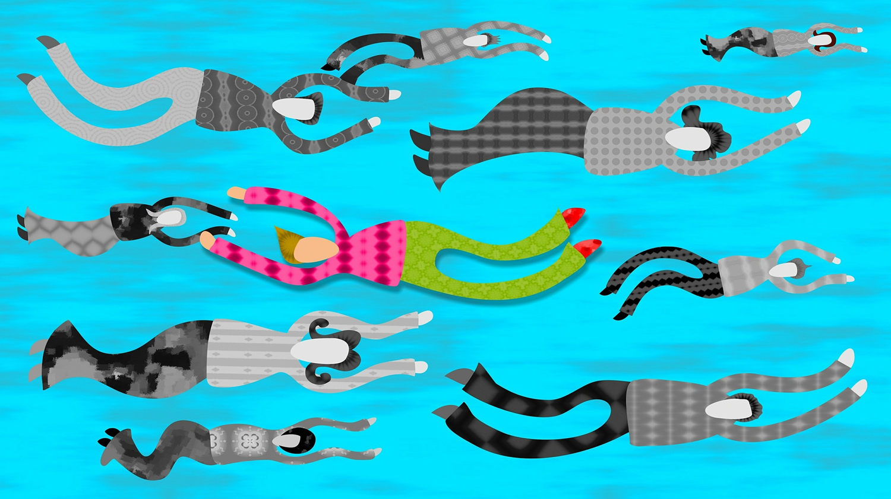
(see Begun, 2016)
Notes:
One problem with labeling someone an “addict,” or “alcoholic,” “substance abuser” or other stigmatizing term is that labels tend to melt away a person’s uniqueness and individuality.
The label becomes who the person is, rather than describing one aspect of what makes up a complex individual. Labels depersonalize. When we apply these labels, the person becomes categorized that way—it becomes their identity. We ignore the rest of who that person is.

Slide 15
hopelessness
vs.
recovery happens
Notes:
The second problem with labeling is that we make assumptions about a person based on the category to which they have been assigned.
For example, when we assign someone to a labeled category, we expect them to stay put. We impose assumptions about the likelihood that they can ever REALLY change. So, once labeled an “addict,” “alcoholic,” “substance abuser,” or with some other substance-related term, we expect they will always fit that label, regardless of situation and regardless of any changes they DO accomplish—at best, maybe they can become an “ex-addict” or a “former addict,” but they remain identified with substance misuse or addiction being their central defining trait.
Put another way, we assume that leopards don’t change their spots.
This reflects a rather hopeless and inaccurate point-of-view: there exists plenty of evidence that people DO change, and recovery DOES happen.

Slide 16

Blame & Shame
(see Goodyear, Koffler, & Chavanne, 2018; Kennedy-Hendriks et al., 2017)
Notes:
Sometimes the language we use about substance misuse implies that a person is to blame for causing their own problems and for problems they may have caused others.
The result of blame is shame and blame calls for punishment. This is a far cry from helping a person assume responsibility for engaging in addictive behaviors and making healthful changes in their lives.

Slide 17


Them
Me/Us
(see Wakeman, 2019)
Notes:
Yet another problem with labeling a person is that it creates social and psychological distance--distancing meant to make the person applying the labels more comfortable.
Labels separate us and emphasize our differences rather than how we are alike. Intentional or unintentional messages conveyed through labels categorize the labeled person as separate from others and from ourselves.
Labeling people establishes a “them versus us” mentality – it emphasizes how “those people” are different from “us” and how they are “not like me”.
“Not like me” is at the very root of stigma.

Slide 18
The Stigma Problem
a mark of disgrace or infamy
a mark of shame or discredit
(a blemish)
A strong feeling of disapproval that most people in a society have about something, especially when this is unfair
(see dictionary.com; dictionary.Cambridge.org; merriam-webster.com;
Hammarlund et al, 2018;Smith et al, 2016; Wogen & Restrepo, 2020)
Notes:
What exactly is stigma? These are some dictionary definitions.
Stigma comes in different forms—it may originate from the general community in which a person functions, from professionals with whom a person might interact, and from within, as self-stigma.
A person’s experiences and behaviors may be affected by both actual and perceived stigma. They also may be influenced by anticipation of encountering stigma.

Slide 19
stigma explicit bias implicit bias
“…the complex of attitudes, beliefs, behaviors, and structures that interact at different levels of society (i.e., individuals, groups, organizations, system) and manifest in prejudicial attitudes about and discriminatory practices against people with mental and substance use disorders”
(see Ashford et al, 2018, 2019a, 2019b; NAS, 2016, p. 33)
Notes:
Here is a more detailed definition of stigma indicating that stigma occurs at all levels of society—from macro-level social policy systems and institutions to communities, families, and individuals.
This definition also addresses implications—stigma manifests in behavior, social structures, policy, and other discriminatory practices: what we call explicit bias.
Explicit bias might be expressed in terms of rules, policies, and procedures concerning substance misuse. Such explicit bias impacts many aspects of life for individuals experiencing substance use disorders: for example, it may impact housing and food security, employment and income stability, social and health care services, and entanglement with criminal justice, child welfare, and legal systems.
Implicit bias, on the other hand, is about underlying, even subconscious beliefs and attitudes. These beliefs and attitudes may influence our behavior in unintentional ways—ways that interfere with our social interactions and engaging together. In terms of clinical practice, implicit bias impedes the formation of therapeutic alliance—the working relationship. Words like “addict” “alcoholic” and substance abuser” should no longer be used in professional or lay settings because of the implicit bias such terms evoke both in ourselves and in others.

Slide 20

Stigma Experience: “Why Try?” Effect
“spoiled identity”
“turning a whole and usual person to a tainted and discounted one”
(see Ashford et al, 2018, 2019a, 2019b; Benz et al, 2019; Camlin et al, 2017 Corrigan et al, 2016;
Goffman, 1963, p. 3; Moore et al, 2020; O’Shay-Wallace, 2020)
Notes:
The sociologist Erving Goffman described the stigma experience as “turning a whole and usual person to a tainted and discounted one” (1963, p. 3). Through repeated experiences of stigma, a person develops what Goffman called a “spoiled identity” where someone feels tainted and experiences a wholesale rejection of their identity.
Stigma marginalizes members of a population. These individuals become systematically excluded, discounted, less enfranchised in society, and categorized as less desirable beings—in some cases, they are rendered invisible.
The inherent dignity of a person is lost.
Loss of self-respect and believing yourself unworthy can result in the “Why Try” phenomenon as it relates to seeking help or otherwise engaging in recovery efforts.
Simply anticipating that stigma will be encountered in future interactions inhibits a person’s willingness to risk the stress of yet another anticipated stigma experience.

Slide 21

Stigma/Social Disapproval
1-Substance Use Disorder
2-HIV Positivity
3-Criminal Record
4-Alcohol Use Disorder
(see Barry et al, 2014; Burda , 2015 p. 14; Crapanzano et al, 2019; Dschaak & Juntunen, 2018;
Hammarlund et al, 2018; Livingston & Boyd, 2010; Room et al 2001; Rose et al, 2014;
van Boekel et al, 2015; Wu et al, 2017)
Notes:
Evidence indicates that individuals experiencing substance use disorders encounter a remarkably high number of stigmatizing experiences, and these experiences may act as personal and systematic barriers for help-seeking and the recovery process.
In a 2000-2001 study comparing stigma related to 18 health or social conditions, conducted across 16 nations, drug addiction was associated with the highest levels of disapproval and alcoholism was 4th highest—HIV positivity was 2nd and having a criminal record for burglary was 3rd.
Evidence is growing that substance use-related stigma impedes access to, engagement in, and retention in treatment and recovery support services, as well as self-efficacy for change. However, evidence concerning how stigma relates to recovery outcomes is somewhat mixed—some research indicates that outcomes are worse when stigma is high, others indicate that recovery outcomes can improve even though stigma may not change over time. Stigma experiences do seem to be more extreme when substance misuse is more severe.

Slide 22

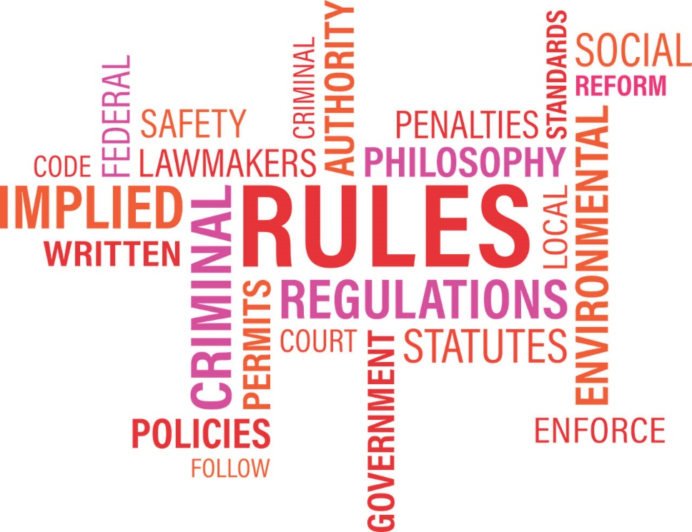
Public Attitudes Influence
Public Policy
(see Barry et al, 2014; Burda , 2015 p. 14; Moore et al, 2020 Room et al 2001;
van Boekel et al, 2015; Wogen & Restrepo, 2020; Yang et al, 2017)
Notes:
Public attitudes influence public policy. A U.S. public opinion study reported that 59% in the general public believed treatment for persons with drug addiction are ineffective and 28% rejected the concept that persons with drug addiction could get well with treatment and return to productive lives. These negative opinions potentially influence budgetary and other policy support for treatment and recovery services, as well as other policies affecting the quality of life for individuals experiencing substance use disorders—policies related to healthcare, employment, housing, child welfare, and criminal justice systems for example. Thus, public stigma and structural stigma become intertwined phenomena.
Low public support for policies addressing needs in this population also relates to other toxic stereotypes commonly held by members of the general public. Research identified perceptions that persons experiencing substance use disorder are potentially dangerous, unpredictable, are incapable of making their own decisions about treatment and other life decisions, to blame or responsible for their substance-related problems, and their treatment prognosis is doubtful.
One aspect of public stigma that requires challenging occurs when individuals who may have engaged in substance use or misuse themselves fail to understand the difference between their own personal experiences and the experiences of persons whose substance misuse has become disordered.

Slide 23

“…the outside becomes the inside.”
self-stigma
(see Birtel et al, 2017; Bronfenbrenner, 1995, p. 602; Can & Tanriverdi, 2015)
Notes:
Uri Bronfenbrenner explained how, in the course of child development, “The outside becomes the inside.”
In other words, explicit and implicit messages expressed by others become internalized and shape our self-concept.
This internalization process is at the root of toxic self-stigma.
Self-stigma results from internalizing stigmatizing beliefs and applying them to oneself. Considerable evidence demonstrates that individuals who experience substance use disorders are subject to a great deal of both public and self-stigma, which in turn, is associated with lower self-esteem, higher depression and anxiety, and more sleep problems.
Looking at the impact of toxic shame and self-stigma, consider this exchange with a woman preparing to reenter the community after serving a sentence for drug-related offenses. She was literally, physically hanging her head in shame, blaming and berating herself for the mistakes she made with her children during the period when she was using drugs. Asked a single question: “Do you learn from your mistakes?” she stopped and stared. She asked, “What do you mean?” The single question was repeated: “Do you learn from your mistakes?” After a long pause while she considered the question, her whole posture straightened up. She lifted her head, looked the other person in the eye, nodded, and said, “Yes, I guess I do.” That was all it took. She accepted responsibility for becoming a better mother.
Blame and shame left her no solutions for moving forward—she could not undo the past. But, seeing herself as someone who learns from past mistakes showed her what she could do moving forward. The new outside message became the new inside.

Slide 24
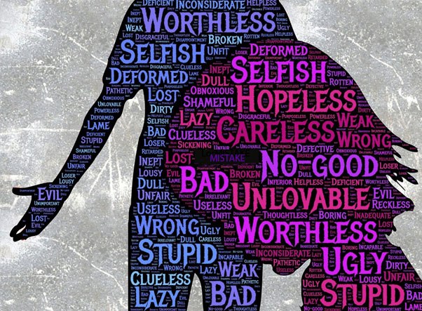
Self-Blame
Self-Shame
Self-Doubt
Self-Stigma
(see Hammarlund et al, 2018; Kulesza et al, 2017)
Notes:
Blame and shame messaging damages a person’s self-concept and self-identity.
Shame and embarrassment over their substance misuse is frequently reported by individuals experiencing a substance use disorder. A majority of participants in one study reported believing that they “have permanently screwed up their lives,” they felt “ashamed,” and they felt “out of place in the world” as a result of their substance misuse.
This experience promotes secrecy about their behavior and acts as a barrier to engaging with recovery support. A person who comes to believe themselves to be hopeless, helpless, unworthy, unlovable, bad, weak, lazy, useless, defective, and otherwise no-good becomes boxed in by toxic self-blame, self-shame, self-doubt, and self-stigma.

Slide 25
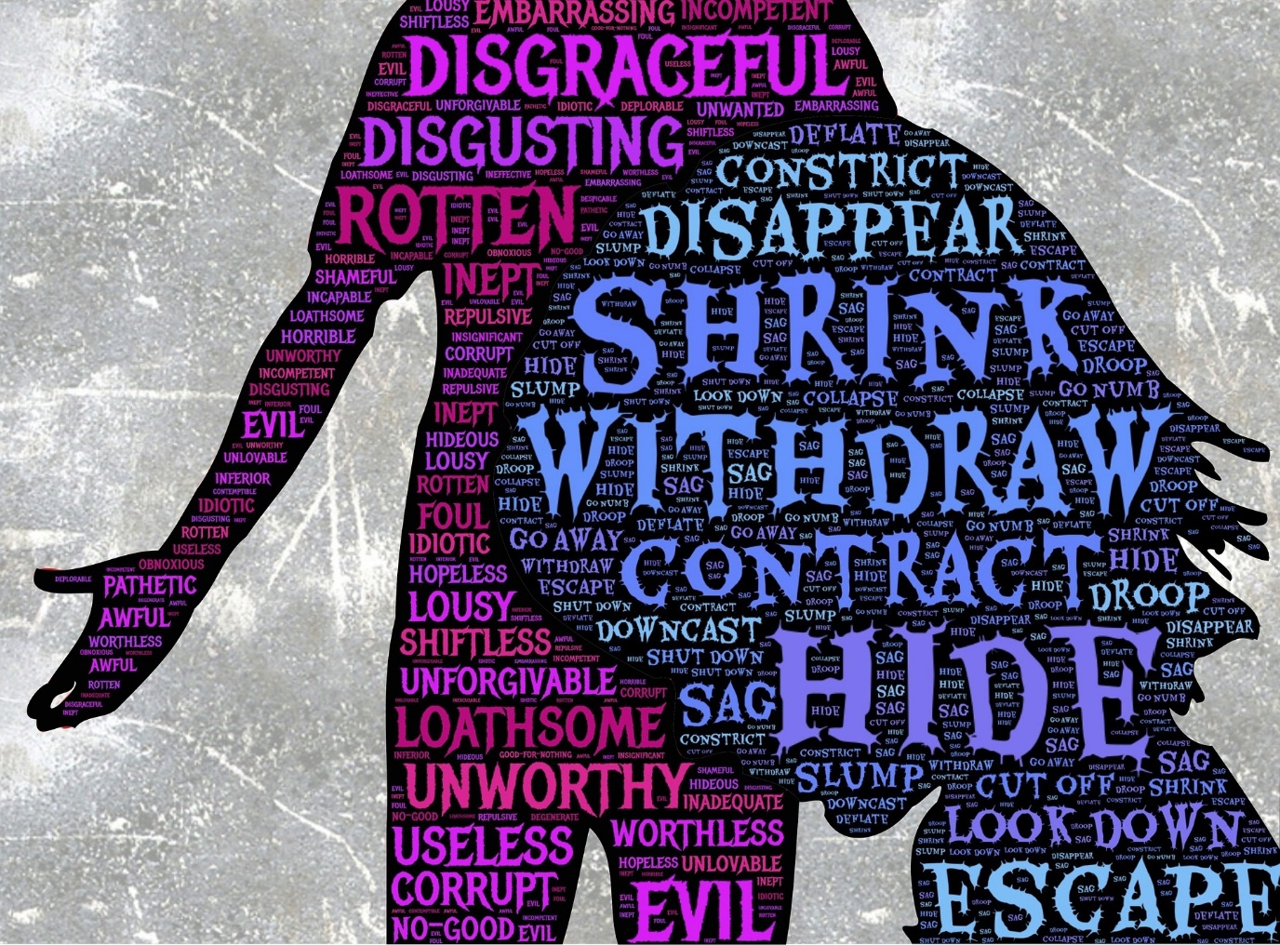
Self-Blame
Self-Shame
Self-Doubt
Self-Stigma
(see Clement et al, 2015; Gutierrez et al, 2020; Tuliao & Holyoak, 2020;
van Boekel et al, 2013; Wakeman, 2019)
Notes:
How does this boxed-in person respond?
They disappear, withdraw, escape, go away, and hide.
This is not fruitful for engaging a person in substance-related change and recovery efforts.
In fact, toxic self-stigma is one of the main reasons that individuals experiencing problems associated with substance misuse might avoid seeking: health or mental health care, harm reduction services, and other recovery support. Unfortunately, there exists considerable evidence that feeling disparaged by others and experiencing external and internalized stigma have a deterrent effect on substance-related help-seeking behavior. Not only is this true in relation substance misuse stigma, it is also true in relation to general help-seeking stigma.
Individuals engaged in services where they encounter these experiences may withdraw from services prematurely, thereby diminishing their recovery outcomes. There exists evidence that individuals who perceived stigma from health care and other service providers were less likely to complete treatment for their substance-related concerns.

Slide 26
Professionals’ Opinions
(see Chang et al, 2015; van Boekel et al, 2013, 2015—graph adapted from 2015, p. 544)
Notes:
Unfortunately, many professionals with whom an individual might engage share some similar stigmatizing beliefs, along with mistrust and perceptions that the person who misuses substances is a “difficult” patient or client. Stigma involves discrediting an individual, labeling, stereotyping, discrimination, and imposing unequal power dynamics in professional interactions. Some may view it as a waste of time to provide services to individuals engaged in substance misuse or experiencing a substance use disorder if they hold a belief that the situation or person cannot change, if they lack a belief that recovery does happen.
Authors of a systematic literature review conducted in 2012 concluded that health professionals generally held negative attitudes toward individuals experiencing problems related to substance misuse and they had less regard for working with this population, lacked empathy towards them, and preferred that addiction specialists handle their care.
A study comparing beliefs held by members of the general public, professionals, and clients in treatment for substance use disorders reported a couple of shared stereotypical beliefs—that these individuals are not trustworthy, tend to be aggressive, and are questionably able to maintain a regular job.
More encouraging were results indicated a high degree of agreement among professionals that someone experiencing addiction can be treated successfully and that addiction is a disease, as well as disagreement that addiction is the consequence of weakness.
Fortuitously, professionals having the most contact with members of this population held the most positive attitudes. Furthermore, education and training about substance misuse had positive impact on professionals’ beliefs and attitudes.

Slide 27

Intersectionality & Stigma Interplay
gender
age
sexual orientation
military
gender identity
veteran
race
trauma
ethnicity
incarcerated
pregnancy
parent
(see Benz et al, 2019 p. 64; Clement et al, 2014; Cockroft et al, 2019; Hammarlund et al, 2018;
Stringer & Baker, 2018; Witte et al, 2019)
Notes:
Compounding the picture, consider what happens when different stigma collide—the intersection or interplay among multiple stigmatized factors.
For example, a systematic review of substance misuse literature concluded that ethnic minorities, youth, men, and those in military and health professions were disproportionately deterred by stigma from help-seeking.
Another review concluded that stigma-related barriers to substance misuse treatment were compounded for individuals who were older, a member of a racial or ethnic minority group, diagnosed with co-occurring depression, or tested positive for HIV infection, and that women faced additional stigmas, especially when pregnant, incarcerated, black, or facing child custody concerns. An additional study demonstrated that, among individuals experiencing unmet substance use treatment needs, women were more likely to report stigma as a barrier to treatment than men, and regardless of gender, parents reported the highest level of stigma.
Yet another study identified the stigma of addiction as a key theme influencing a lack of trust in the health care system held by women seeking treatment—the intersectionality and stigma interplay related to the very high rate of trauma these women have experienced which, in turn, potentially affected their trust and formation of interpersonal relationships which are fundamental to engaging in recovery support.

Slide 28

Identifying as both [gender or sexual minority] and as an “addict” constitutes membership in two groups that are marginalized by the larger society.
(see Benz et al, 2019 p. 64; Clement et al, 2014)
Notes:
And, evidence abounds that individuals who identify as a gender or sexual minority underutilize treatment for substance-related concerns to an even greater extent than their peers, leading to treatment delay or avoidance that can contribute to more serious problems developing.

Slide 29

racialization
white race
non-white race
STIGMA
medicalization
criminalization
(see Begun, 2019; Mendoza, Hatcher, & Hansen, 2019—figure adapted from p. 133)
Notes:
Or, for example, consider the racialization evident in the interplay between opioid use disorder and race. This adapted diagram indicates that medicalization responses are more likely for members of the white race and, as stigma compound and increases for members of non-white races, criminalization responses are more likely. The confounding of racial, and ethnic discrimination with stereotypes concerning criminality and substance use patterns has a very long history in the United States and our policy responses.

Slide 30

Three Strikes
female
substance misuse
incarceration
(see Begun & Rose, 2007; Bush-Baskette, 2010; Harp & Oser, 2018; Reed, 1985)
Notes:
Another example of the interplay between different types of stigma is evident in literature concerning women who have experienced a substance use disorder and also been incarcerated—not only are there typically fewer jail or prison-based substance misuse treatment services available to incarcerated women compared to incarcerated men, stigma surrounding substance misuse by women, especially mothers, is extensive and likely contributes to their being underserved.
Considering intersectionality and stigma, criminal justice system sanctions and incarceration are disproportionately imposed on persons of color, a fact heavily shaped by the nation’s War on Drugs—a long-standing policy position which has been referred to as a War on Black Women. In essence, race makes 4 strikes experienced by many incarcerated women.

Slide 31

“Stigmatization of families supporting an adult member with substance misuse is common and undermines their capacity to support the person and maintain their own well-being.”
Family
Experiences
with Stigma
(see McCann & Lubman, 2018, p. 693-694; O’Shay-Wallace, 2020; Wilkens & Foote, 2019)
Notes:
Let’s turn our attention now to stigma as experienced by family members—all too often, families share an individual member’s stigma. This is sometimes referred to as “courtesy stigma” or “associative stigma.”
Family members may endure hearing other people talking in derogatory ways or making insensitive jokes about the person they love. Or they find that others “diagnose” them as being “codependent” or blaming them as “enablers”—two highly stigmatizing labels poorly supported by a scientific evidence base.
What we previously explored about an individual’s toxic self-stigma extends to family members, as well. They, too, may be subjected to a loss of respect, blame, shame, pity, criticism, unwelcome advice, or suspicion that they are in some way contaminated, too. Extended family members may stress that “it didn’t come from OUR side of the family” or someone might expound, “If it was MY kid (or partner or parent), I would …[dot] [dot] [dot],” concluding with any number of hurtful statements.
An Australian study concerning family members’ experiences of stigma described how family members all too often were referred to in unsympathetic and derogatory ways, as possessing character defects, and having co-dependent relationships that perpetuate or enable the person’s substance misuse. Not only do family members experience public stigma, they assume aspects of self-stigma and self-blame, as well.
In reaction, family members may become cut off from extended family and friends, engage in secrecy, and avoid contact with others who show a lack of knowledge and empathy and express judgmental attitudes. Participants in one study described the many ways they tried to avoid stigma situations and hide their family situation, thus extending the family’s sense of isolation. They may hesitate to seek help because of their own experiences with toxic stigma. One family member described the experience as “feeling like a pariah.”
Health care and service providers need to make themselves aware of ways that family members experience explicit and implicit bias or stigma and how these experiences might affect families and family members’ well-being and participation in supporting someone’s recovery.
Participants in two studies described the efforts and measures they took to moderate the effects of stigma—such as challenging misconceptions about substance misuse, challenging public stigma and stereotypes, and challenging the application of stigma to themselves and their family members. But this requires a great deal of knowledge, advocacy skill, support, and courage.
Family members may even feel pressured to make difficult choices between the individual’s well-being versus the well-being of the family-as-a-whole. Ambivalence surrounding these difficult choices may make them seem inconsistent as they try to navigate a tortuous path between rocks and hard places.
Also in family members’ response repertoire is being selectively open with others about the individual’s and the family’s situation—choosing with care who, when, and how others are informed.

Slide 32
The Disclosure Experience
Stigma
they treat you differently
people are going to talk
Social Support
my friends changed their lifestyles to benefit me
people encouraged me to attend treatment
I’ll be judged for doing something wrong that made my child that way
my friends are good at telling me I’m doing the right thing for my child, they comfort me
(see Earnshaw et al, 2019; McCann & Lubman, 2018; Paris et al, 2020)
Notes:
Family members also may respond with being selectively open with others about the family’s situation—choosing with care who, when, and how others are informed.
Family members and individuals in treatment for or recovery from substance use disorders may disagree about disclosure to others.
Disclosure may be forced on them for reasons of excused absences from school or work, or because their behavior compared to when they previously engaged in substance misuse is noted by others. Disclosure by pregnant women is a particularly sensitive concern.
Reactions these individuals and family members experience may have a considerable impact on their psychological and behavioral outcomes—depending on whether the reactions reflect stigma or social support.
Perceived or anticipated stigma is a major reason why individuals and family members avoid disclosure. As I explain at the start of every semester to students in my substance misuse course, they may not have permission from their family members to disclose information about their own or their family members’ substance use—self-disclosure is also family disclosure, so they need to be thoughtful about what they choose to disclose within our learning context.

Slide 33
The Disclosure Experience
Stigma
they treat you differently
people are going to talk
Social Support
my friends changed their lifestyles to benefit me
people encouraged me to attend treatment
I’ll be judged for doing something wrong that made my child that way
my friends are good at telling me I’m doing the right thing for my child, they comfort me
“There are some people you can talk with, some people you can’t”
Notes:
As a family member stated: “There are some people you can talk with, some people you can’t”

Slide 34
Making a Difference: Addressing Substance-Related Stigma
change
the person/ family
change interface
change
the environment
(see Begun, 2016, 2019)
Notes:
Where do all these concerns about stigma leave us?
Actually, we have available to us a realm of options for addressing substance-related stigma and its aftermath.

Slide 35
Options
change
the person/ family
change
the environment
change interface
CBT/Coping Skills Training
Individual & Family Counseling
Change the Narratives
(see Begun, 2016, 2019; Dunlop & Tracy, 2013; Gutierrez et al, 2020; Silverman, 2020)
Notes:
First, we can enlist approaches for helping to change the person or family affected by stigma.
Change-the-person or family interventions may be incorporated into most forms of evidence-supported and evidence-based treatment related to substance misuse concerns. For example, Cognitive Behavioral Therapy interventions are designed to help change how a person interprets their experiences as a means of helping them change their behavioral responses to those experiences. Likewise, with coping skills training. These are ideal venues for helping a person change self-stigma, their anticipation of stigma, how they perceive stigma from others, and how they respond.
Other therapeutic interventions may help individuals develop counter narratives to the stigmatizing messages and stereotypes they encounter or may have incorporated into self-stigma.
An interesting study of individuals in recovery from an alcohol use disorder identified a distinct difference in the personal narratives shared by individuals comfortably in recovery compared to those struggling in recovery.
When their personal narratives contained elements of self-redemption, describing themselves as undergoing a positive personality change, the individuals were almost twice as likely to be comfortably in recovery compared to when their narratives were non-redemptive. It is unclear whether overcoming self-stigma and developing narratives that counter stigmatizing stereotypes may have a positive impact on recovery outcomes, or if it is the other way around.
In a unique music therapy intervention study, engaging individuals in detoxification care to write blues music song lyrics addressing stigma showed no statistically significant differences in participants’ perceived stigma and social support. However, the therapeutic use of song-writing offered a creative clinical opportunity for individuals to explore the impact of stigma and social support in their lives.

Slide 36
Options
change
the person/ family
change interface
change
the environment
(see Begun, 2016, 2019)
Notes:
Second, we can engage in creative options for changing the environment—making change in the neighborhood, work or school, social network, support network, health care and service delivery systems, mass media, social media, and policies that form the social and physical contexts where these individuals and family members function.
We paid attention to language use in the first part of this presentation—changing the environment and culture related to substance misuse can begin with efforts to address stigmatizing language use ourselves and wherever we might encounter it personally and professionally.
For example, since about 2013, professional journal editors and professional organizations have begun advocating for non-stigmatizing language related to substance use—including in our clinical records, charting practices, and other forms of communication. The White House Office of National Drug Control Policy (or ONDCP) published a 2017 memorandum advocating for a shift in all federal departments and agencies to promote use of non-stigmatizing substance-related language.
So, just how DO we practice these behaviors? What does that look like?

Slide 37
Using
Person-First Language
adolescent engaged in substance misuse
woman in recovery
man experiencing an alcohol use disorder
(see Begun, 2016; Broyles et al, 2014; ONDCP, 2017; Robinson, 2016)
Notes:
We begin with using person-first language.
This means starting with words designating personhood—words like person, individual, man, woman, child, adolescent, or adult.
Qualifiers come after the person-first designation—and describe a person’s experience or behavior.
For example, “a person who engages in injection drug use” is preferable to labeling them as a “drug injector.“
And, “a person experiencing a substance use disorder” is preferable to labeling them as an “addict.”
Other examples of person-first language might be “an adolescent engaged in substance misuse,” “a man experiencing an alcohol use disorder,” and “a woman in recovery.”
Person-first language conveys respect and emphasizes dignity and respect by defining someone as a person—regardless of whatever else is involved, they are first and foremost still a person.
Just to test yourself—how might you respond to the label “children of alcoholics?”
How might you revise use of that label in non-stigmatizing ways?
[Pause] How about describing them as children with a parent experiencing an alcohol use disorder?

Slide 38
(see https://www.recoveryanswers.org/addiction-ary/ )
Notes:
Fortunately, we have access to some great resources to help us monitor evolving trends in substance-related language use.
For example, the Addictionary, assembled by the Recovery Research institute, provides a glossary of substance-related terminology.

Slide 39
(see https://www.recoveryanswers.org/addiction-ary/ )
Notes:
Not only does the Addictionary provide descriptions of frequently encountered terms, it presents “stigma alerts” where relevant and explains why using a certain term might be problematic.

Slide 40
(see NIDA, 2020; Reber et al, 2020 )
Notes:
The National Institute on Drug Abuse published a handout about reducing stigma through more thoughtful use of language related to substance misuse.
Not only does it identify potentially stigmatizing terms, it offers alternatives and explains the rationale behind the recommended changes.
For example, the handout explains non-stigmatizing alternatives to the term “addicted baby,” such as a baby with signs of neonatal withdrawal syndrome— person-first and clinically accurate language.
It is worth noting that many clinicians are shifting away from the term neonatal abstinence syndrome to the term neonatal withdrawal syndrome because of stigmatizing behavioral connotations associated with the term abstinence and greater clinical accuracy of the term withdrawal syndrome.

Slide 41

“Don’t pick up a drink or drug, one day at a time. It sounds so simple. It actually is simple, but it isn’t easy…”
habit
-Russell Brand
(see Brand, 2009; NIDA,2020 )
Notes:
Let’s focus for a moment on a few other potentially problematic terms, starting with the word is Habit.
Dictionary synonyms for habit include: inclination, proclivity, tendency, and even groove.
The word Habit suggests that a person could just stop using alcohol or other psychoactive substances if they were so inclined or simply chose to do so.
A word like “habit” soft-pedals the difficulty of overcoming powerful and compelling neurobiological, psychological, social context, and physical environment forces acting on a person’s substance misuse or substance use disorder.
This word “habit” undermines the seriousness and severity of substance use disorders and the effort involved in change attempts and recovery.

Slide 42
clean
dirty
negative
positive
(see ONDCP, 2017; Wakeman, 2019; https://www.recoveryanswers.org/addiction-ary/ )
Notes:
Another consideration relates to describing a person’s drug test results.
Clean and dirty are, by extension, describing the person, not just the test result.
Instead, use medical terminology that describes the test, not the person—the test was either negative or positive for substances.
This shift in language fits into a paradigm where we move away from and discourage applying a moral failure lens to substance misuse behavior and replace it with understanding the underlying biopsychosocial forces at play.
At a policy level, this translates into moving away from punitive and criminal justice responses and promoting treatment, harm reduction, and recovery support responses.

Slide 43
codependent
enabler
(see https://www.recoveryanswers.org/addiction-ary/ )
Notes:
Consider terms encountered by family members of a person experiencing a substance use disorder.
The Addictionary places a “stigma alert” on the word co-dependency, explaining that it tends to pathologize a family member’s concern and care about a person engaged in substance misuse. A label like codependent provokes shame and blame.
The term also tends to ignore the reality that a family member actually may be physically, economically, legally, or otherwise situationally reliant on that person.
For similar reasons, the term enabling is accompanied by a “stigma alert” in the Addictionary.
The term infers blame on the family member for making an individual’s condition worse by interrupting naturally occurring negative consequences of their substance misuse behavior. This concept ignores and pathologizes much of what we know about family systems—a whole different presentation topic.
In short, we can begin helping to reduce the experience of stigma for individuals and families with our own careful use of language. And, we can have an impact on the broader culture when we advocate for change in how others use language, as well.
As an extension of our challenging the use of stigmatizing language, we can all work to challenge public stigma by challenging all sorts of messaging and media portrayals that contribute to substance-related stigma and stereotypes.

Slide 44

Professional Education
(see MacLean, 2018; Robinson, 2017; Solo & Stuart, 2014; Verhaeghe & Bracke, 2012)
Notes:
On the topic of changing culture through professional education…
A team in Canada tested a comprehensive set of tools for providers to reduce stigma. Training workshops that integrated these resources contributed to professionals’ increased awareness of stigma; greater comfort discussing harm reduction and substance use with their clients or patients; and increased awareness of organizational strategies to reduce stigma. The team concluded that providers are motivated to engage in best practices when prepared to do so.
For example, one organizational or institutional change strategy relates to promoting the use of non-stigmatizing language in professional communications, records, and charting practices.
Along with continuing education efforts, stigma, stereotypes, and attitudes need to be addressed in pre-service education, as well. Evidence indicates that social work, nursing, medical, and other professional students come to training with beliefs, stereotypes, and attitudes about individuals who engage in substance misuse, their families, and prospects for treatment and recovery—beliefs and stereotypes that they may need to unlearn.
As an interesting addition, professionals providing services to a stigmatized population also may experience “associative stigma” in much the same way we saw that family members might.
This associative stigma may contribute to professionals’ experience of burnout and low job satisfaction. Fortunately, this phenomenon of perceived or experienced associative stigma appears to be relatively uncommon.

Slide 45
Options
change
the person/ family
change interface
change
the environment
(see Begun, 2016, 2019)
Notes:
Third in our list of options is influencing the ways the individual interacts with their environment. We’ve looked at a few “change the person” strategies and some with the potential for changing the social environment. Let’s look at addressing the interplay between person and environment.

Slide 46

Therapeutic Citizenship (advocates & change agents)
Change The Person & The Culture
“…engaging in recovery related advocacy offers a multitude of potential benefits and positive impacts”
(see Ashford et al, 2019b, p. 462; Camlin et al, 2017)
Notes:
Therapeutic citizenship is a model that both changes individuals and changes social environments.
Therapeutic citizenship is essentially about becoming an advocate for change—serving as a representative of a stigmatized group who can challenge stereotypical and stigmatizing beliefs and attitudes from the strength of a positive example. Therapeutic citizenship, on one hand, can offer an individual a sort of redemption from their prior “spoiled identity,” replacing it with a valorized social identity and restore self-esteem.
Engaging in therapeutic citizenship as advocates and change agents helps internalize a recovery identity, supports reframing and reconceptualizing the past as a source of empowerment and meaning, and provides social networking opportunities within a recovery support community. Some recovery programs emphasize altruism and service, and within a Stages of Change model, this type of activity is often associated with recovery maintenance.
Thus, engaging in public advocacy and efforts to create more responsive recovery support systems for others has potential therapeutic value for individuals and, at the same time, helps change environments on their own and others’ behalf.
As a caution, individuals in one study identified as potential harms that they may set themselves up to experience additional stigma and discrimination, that advocacy activities may interfere with their ability to engage in self-care, and that the benefits may not outweigh the personal costs or harms.

Slide 47
National Alliance for Medication Assisted Recovery
(see Woods & Joseph, 2012)
Notes:
The MARS project, which stands for Medication Assisted Recovery Services, is another example of how therapeutic citizenship promotes change in both individuals and the social context.
Sponsored by the National Alliance for Medication Assisted Recovery, the peer-initiated, peer-based MARS project delivers education to dispel stigma concerning buprenorphine and methadone treatment with the aim of improving treatment outcomes. MARS sponsors recovery support groups, substance-free social activities, recovery celebratory events, and peer leader training and mentoring. The organization hosts training and a certification exam for individuals to become certified as medication assisted treatment advocates and engaged a peer council to help direct the project. Together with other groups, NAMA Recovery sponsored a group called Stop Stigma Now, working to create a focused national public relations and marketing campaign for educating professionals, policy makers, families, the criminal justice system, and the general public about the medications to treat addiction with the goal of ending the pervasive social stigma surrounding medication-assisted treatment.

Slide 48
Peer Recovery Support &
Anti-Stereotypes
Stereotypes Challenged:
Reckless, impulsive, uncontrollable, self-destructive, unpredictable, unable to keep a job, going to relapse
Unreliable, selfish, weak, hopeless
Inadequate, dirty, worthless, lazy, losers
Threat, criminals, cheaters/liars
Responses Antithetical To:
Anger, resentment, hatred
Pity, sadness, worry
Dread, fear, paranoia, disgust, wariness
(see McGinty et al, 2015; Nieweglowski et al, 2019)
Notes:
Aside from the plentiful evidence that peer recovery support can have a significant positive impact on recovery outcomes, consider the potential of exposure to individuals who are flourishing as a means of challenging prevailing public, professional, and self- stigmatizing stereotypes about persons who have experienced a substance use disorder.
Stereotypes and prejudicial responses that we might challenge in this way include: recklessness, unreliability, inadequacy, and threat stereotypes,
Peer counselors can present alternative images, the opposite to each of these stereotypes and can draw a very different response set—replacing responses of anger, pity, and dread with respect.
They portray substance use disorders as treatable and reinforce the message that recovery happens. Evidence exists that portraying substance use disorders as treatable can improve public attitudes and reduce stigma related to substance misuse. Investigators in one study concluded that portrayal of persons with successfully treated substance use disorders is a promising strategy for reducing stigma and discrimination, as well as improving public perceptions of treatment effectiveness, which in turn, may influence policy favoring recovery support services.

Slide 49
Summary
common
negative impact
language use
strategies & resources
(see drugabuse.com/addiction/stigma/ )
Notes:
So, what did we address in this presentation?
That stigma is a common experience for individuals engaged in substance misuse, treatment, and recovery, as well as for their families.
That the experience of public, professional, and self-stigma negatively impacts help-seeking and recovery efforts.
That the language we use can be stigmatizing—we advocate for non-stigmatizing language use. And, when we slip up in practicing these new skills, we need also to practice forgiveness and learn from our mistakes.
We identified strategies and resources for addressing stigma and reducing its negative impact—promoting change with individuals, their family, communities, organizations, institutions, and policies.
As professionals and concerned community members, from our very first outreach and engagement encounters, through screening, assessment, treatment intervention, recovery support, prevention interventions and even our policies and practice environments, it is important to consider not only how we might inadvertently communicate stigma about substance misuse and people experiencing substance use disorders but also our responsibility to advocate for and respect their inherent dignity.

Slide 50
educate others
language use
speak out & advocate
(see Zwick et al, 2020)
Notes:
Recommended actions we can take include:
Educating others—in the general public and among professionals—about substance misuse, evidence supported treatment, that treatment work and recovery happens, and about stigma
Use language with care, communicate the personhood of individuals who engage in substance misuse and their family members, and respect their inherent dignity and personhood.

Slide 51
“Addiction is not the entirety of me.
I am me;
I am not just my addiction.”
(see drugabuse.com/addiction/stigma/ )
Notes:
In the language of recovery support…
The message is that I am still a person.

Slide 52
References
Ashford, R.D., Brown, A.M., & Curtis, B. (2018). Substance use, recovery, and linguistics: The impact of word choice on explicit and implicit bias. Drug and Alcohol Dependence, 189, 131-138.
Ashford, R.D., Brown, A.M., & Curtis, B. (2019a). The language of substance use and recovery: Novel use of the Go/No-Go association task to measure implicit bias. Health Communication, 34(11), 1296-1302.
Ashford, R.D., Brown, A.M., Canode, B., McDaniel, J., & Curtis, B. (2019b). A mixed-methods exploration of the role and impact of stigma and advocacy on substance use disorder recovery. Alcoholism Treatment Quarterly, 37(4), 462-480.
Barry, C.L., McGinty, E.E., Pescosolido, B.A., & Goldman, H.H. (2014). Stigma, discrimination, treatment effectiveness, and policy: Public views about drug addiction and mental illness. Psychiatric Services, 65(10), 1269-1272.
Begun, A.L. (2016). Considering the language we use: Well worth the effort. Journal of Social Work Practice in the Addictions, 16(3), 332-336.
Begun, A.L. (2019). Theories and biological basis of addiction: Part I and Part II (revised). The Ohio State University: Pressbooks Open Educational Resource (OER). https://ohiostate.pressbooks.pub/substancemisusepart1/ & https://ohiostate.pressbooks.pub/substancemisusepart2/
Begun, A.L., & Rose, S.J. (2007) Three strikes: Substance abusing, female, and in jail. Morris Fromkin Memorial Lecture. Milwaukee, WI: University of Wisconsin-Milwaukee.
Benz, M.B., Reed, K.P., & Bishop, L.S. (2019). Stigma and help-seeking: The interplay of substance use and gender and sexual minority identity. Addictive Behaviors, 97, 63-69.
Birtel, M.D., Wood, L., & Kempa, N.J. (2017). Stigma and social support in substance abuse: Implications for mental health and well-being. Psychiatry Research, 252, 1-8.
Notes:
I am clicking through the reference slides rather quickly—if you need to see details, feel free to use the pause button.

Slide 53
Brand, R. (2007). My booky wook: A memoir of sex, drugs, and stand-up. London: Hodder & Stoughton.
Broadus, A.D., & Evans, W.P. (2015). Developing the public attitudes about addiction instrument. Addiction Research & Theory, 23(2), 115-13
Broyles, L.M., Binswanger, I.A., Jenkins, J.A., Finnell, D.S., Faseru, B., Cavaiola, A.,…Gordon, A.J. (2014). Confronting inadvertent stigma and pejorative language in addiction scholarship: A recognition and response. Substance Abuse, 35, 217-221.
Burda, C. (2015). Substance use disorders: Semantics and stigma. The Nurse Practitioner, 45(1), 14-17.
Bush-Baskette, S. (2010). Misguided justice: The War on Drugs and the incarceration of black women. Bloomington, IN: iUniverse.
Camlin, C.S., Charlegois, E.D., Geng, E., Semitala, F., Wallenta, J., Getahun, M., … Havlir, D.V. (2017). Redemption of the “spoiled identity:” The role of HIV-positive individuals in HIV care cascade interventions. Journal of the International AIDS Society, 20: e25023.
Can, G., & Tanriverdi, D. (2015). Social functioning and internalized stigma in individuals diagnosed with substance use disorder. Archives of Psychiatric Nursing, 29, 441-446.
Chang, J., Dubbin, L., & Shim, J. (2015). Negotiating substance use stigma: The role of cultural health capital in provider-patient interactions. Sociology of Health & Illness, 38(1), 90-108.
Clement, S., Schauman, O., Graham, T., Maggioni, F., Evans-Lacko, S., Bezborodovs, N., … Thornicroft, G. (2015). What is the impact of mental health-related stigma on help-seeking? A systematic review of quantitative and qualitative studies. Psychological Medicine, 45, 11-27.
Cockroft, J.D., Adams, S.M., Bonnet, K., Matlock, D., McMillan, J., & Schlundt, D. (2019). “A scarlet letter”: Stigma and other factors affecting trust in the health care system for women seeking substance abuse treatment in a community setting. Substance Abuse, 40(2), 170-177.
Corrigan, P.W., Bink, A.B., Schmidt, A., Jones, N., & Rüsch, N. (2016). What is the impact of self-stigma? Loss of self-respect and the “why try” effect. Journal of Mental Health, 25(1), 10-15.

Slide 54
Crapanzano, K.A., Hammarlund, R., Ahmad, B., Hunsinger, N., & Kullar, R. (2019). The association between perceived stigma and substance use disorder treatment outcomes: A review. Substance Abuse and Rehabilitation, 10, 1-12.
Dunlop, W.L., & Tracy, J.L. (2013). Sobering stories: Narratives of self-redemption predict behavioral change and improved health among recovering alcoholics. Journal of Personality and Social Psychology, 104(3), 576-590.
Dschaak, Z.A., & Juntunen, C.L. (2018). Stigma, substance use, and help-seeking attitudes among rural and urban individuals. Journal of Rural Mental Health, 42(3/4), 184-195.
Earnshaw, V.A., Bogart, L.M., Menino, D.D., Kelly, J.F., Chaudoir, S.R., Reed, N.M., & Levy, S. (2019). Disclosure, stigma, and social support among young people receiving treatment for substance use disorders and their caregivers: A qualitative analysis. International Journal of Mental Health and Addiction, 17, 1535-1549.
Goffman, E. (1963). Stigma: Notes on the management of spoiled identity. Englewood Cliffs, NJ: Prentice Hall.
Goodyear, K., Haass-Koffler, C.L., & Chavanne, D. (2018). Opioid use and stigma: The role of gender, language and precipitating events. Drug and Alcohol Dependence, 185, 339-346.
Gutierrez, D., Crowe, A., Mullen, P.R., Pignato, L., & Fan, S. (2020). Stigma, help seeking, and substance use. The Professional Counselor, 10(2), 220-234.
Hammerlund, R., Crapanzano, K.A., Luce, L., Mulligan, L., & Ward, K.M. (2018). Review of the effects of self-stigma and perceived social stigma on the treatment-seeking decisions of individuals with drug- and alcohol-use disorders. Substance Abuse and Rehabilitation, 9, 115-136.
Harp, K.L.H., & Oser, C.B. (2018). A longitudinal analysis of the impact of child custody loss on drug use and crime among a sample of African American mothers. Child Abuse & Neglect, 77, 1-12.
Kelly, J.F., & Westerhoff, C.M. (2010a). Does it matter how we refer to individuals with substance-related conditions? A randomized study of two commonly used terms. International Journal of Drug Policy, 21, 202-207.

Slide 55
Kelly, J.F., & Westerhoff, C.M. (2010b). Does our choice of substance-related terms influence perceptions of treatment need? An empirical investigation with two commonly used terms. Journal of Drug Issues, 40(4), 805-818.
Kulesza, M., Watkins, K.E., Ober, A.J., Osilla, K.C., & Ewing, B. (2017). Internalized stigma as an independent risk factor for substance use problems among primary care patients: Rationale and preliminary support. Drug and Alcohol Dependence, 180, 52-55.
Livingston, J.D., & Boyd, J. (2010). Correlates and consequences of internalized stigma for people living with mental illness: A systematic review and meta-analysis. Social Science & Medicine, 71, 2150-2161.
MacLean, R. (2018). Resources to address stigma related to sexuality, substance use and sexually transmitted and blood-borne infections. Canada Community Disease Report, 44(2), 62-67.
McCann, T.V., & Lubman, D.I. (2018). Stigma experience of families supporting an adult member with substance misuse. International Journal of Mental Health Nursing, 27, 693-701.
McGinty, E.E., Goldman, H.H., Pescosolido, B., & Barry, C.L. (2015). Portraying mental illness and drug addiction as treatable health conditions: Effects of a randomized experiment on stigma and discrimination. Social Science & Medicine, 126, 73-85.
Moore, M.D., Ali, S., Burnich-Line, D., Gonzales, W., & Stanton, M.V. (2020). Stigma, opioids, and public health messaging: The need to disentangle behavior from identity. American Journal of Public Health, 110(6) 807-810.
Mendoza, S., Hatcher, A.E., & Hansen, H. (2019). Race, stigma, and addiction. In J.D. Avery & J.J. Avery, (Eds.), The stigma of addiction: An essential guide, (pp.131-152). Cham, Switzerland: Springer Nature.
National Academies of Science, Engineering, and Medicine (NAS). (2016). Ending discrimination against people with mental and substance use disorders: The evidence for stigma change. Washington, DC: National Academies Press. Retrieved from https://www.ncbi.nlm.nih.gov/books/NBK384915/
National Institute on Drug Abuse (NIDA). (2020). Words matter—Terms to use and avoid when talking about addiction. Retrieved from https://www.drugabuse.gov/nidamed-medical-health-professionals/health-professions-education/words-matter-terms-to-use-avoid-when-talking-about-addiction

Slide 56
Nieweglowski, K., Dubke, R., Mulfinger, N., Sheehan, L., & Corrigan, P.W. (2019). Understanding the factor structure of the public stigma of substance use disorder. Addiction Research & Theory, 27(2), 156-161.
Office of National Drug Control Policy (ONDCP). (2017). Changing the language of addiction. Retrieved from https://www.whitehouse.gov/sites/whitehouse.gov/files/images/Memo%20-%20Changing%20Federal%20Terminology%20Regrading%20Substance%20Use%20and%20Substance%20Use%20Disorders.pdf
O’shay-Wallace, S. (2020). “We weren’t raised that way”: Using stigma management communication theory to understand how families manage the stigma of substance abuse. Health Communication, 35(4), 465-474.
Paris, R., Herriott, A.L., Maru, M., Hacking, S.E., & Sommer, A.R. (2020). Secrecy versus disclosure: Women with substance use disorders share experiences in help seeking during pregnancy. Maternal and Child Health Journal.
Reber, K.M., Schlegel, A.B., Braswell, E.F., & Shepherd, E.G. (2020). Neonatal abstinence syndrome: Recognition, management, and prevention. In A.L. Begun & M.M. Murray, (Eds.), The Routledge handbook of social work and addictive behaviors, (pp. 158-173). NY: Routledge.
Reed, B.G. (1985). Drug misuse and dependency in women: The meaning and implications of being considered a special population or minority group. The International Journal of the Addictions, 20(1), 13-62.
Robinson, S.M. (2017). “Alcoholic” or “Person with alcohol use disorder”? Applying person-first diagnostic terminology in the clinical domain. Substance Abuse, 38(1), 9-14.
Silverman, M.J. (2019). Therapeutic songwriting for perceived stigma and perceived social support in adults with substance use disorder: A cluster-randomized effectiveness study. Substance Use & Misuse, 55(5), 763-771.
Room, R., Rehm, J., Trotter, R.T., Pagla, A., & Ustun, R.B. (2001). Cross-cultural views on stigma, valuation, parity, and societal values towards disability. In T.B. Üstün, S. Chatterji, J. Rehm, S. Saxena, & J.E. Bickenbach (Eds.), Disability and culture: Universalism and diversity, (pp. 247-291). Seattle, WA: Hogrefe & Huber.

Slide 57
Rose, S.J., LeBel, T.P., Begun, A.L., & Fuhrmann, D. (2014). Looking out from the inside: Incarcerated women’s perceived barriers to treatment of substance use. Journal of Offender Rehabilitation, 54(4), 310-316.
Smith, L.R., Earnshaw, V.A., Copenhaver, M.M., & Cunningham, C.O. (2016). Substance use stigma: Reliability and validity of a theory-based scale for substance-using populations. Drug and Alcohol Dependence, 162, 34-43.
Snodgrass, S. (2018). The power of words: Changing the language of addiction. Retrieved from http://broken-no-more.org/power-words/
Soto, S.J., & Stuart, M.J. (2014). Beliefs about substance abusing clients among social work students. CSUSB Scholarworks. Retrieved from https://scholarworks.lib.csusb.edu/etd/17
Stringer, K.L., & Baker, E.H. (2018). Stigma as a barrier to substance abuse treatment among those with unmet need: An analysis of parenthood and marital status. Journal of Family Issues, 39(1), 3-27.
Tuliao, A.P., & Holyoak, D. (2020). Psychometric properties of the perceived stigma towards substance users scale: Factor structure, internal consistency, and associations with help-seeking variables. The American Journal of Drug and Alcohol Abuse, 46(2), 158-166.
van Boekel, L.C., Brouwers, E.P.M., van Weeghel, J., & Garretsen, H.F.L. (2013). Stigma among health professionals towards patients with substance use disorders and its consequences for healthcare delivery: Systematic review. Drug and Alcohol Dependence, 131, 23-35.
van Boekel, L.C., Brouwers, E.P.M., van Weeghel, J., & Garretsen, H.F.L. (2015). Comparing stigmatising attitudes towards people with substance use disorders between the general public, GPs, mental health and addiction specialists and clients. International Journal of Social Psychiatry, 61(6), 539-549.
Verhaeghe, M., & Bracke, P. (2012). Associative stigma among mental health professionals: Implications for professional and service user well-being. Journal of Health and Social Behavior, 53(1), 17-32.
Wakeman, S.E. (2019). The language of addiction. In J.D. Avery & J.J. Avery, (Eds.), The stigma of addiction: An essential guide, (pp.71-80). Cham, Switzerland: Springer Nature.

Slide 58
Wilkens, C., & Foote, J. (2019). “Bad parents,” “codependents,” and other stigmatizing myths about substance use disorder in the family. In J.D. Avery & J.J. Avery, (Eds.), The stigma of addiction: An essential guide, (pp.33-54). Cham, Switzerland: Springer Nature.
Witte, T.H., Wright, A., & Stinson, E.A. (2019). Factors influencing stigma toward individuals who have substance use disorders. Substance Use & Misuse, 54(7), 1115-1124.
Wogen, J., & Restrepo, M.T. (2020). Human rights, stigma, and substance use. Health and Human Rights Journal, 22(1), 51-60.
Woods, J.S., & Joseph, H. (2012). Reducing stigma through education to enhance medication-assisted recovery. Journal of Addictive Diseases, 31, 226-235.
Wu, I.H., Bathje, G.J., Kalibatseva, Z., Sung, D.H., Leong, F.T.L., & Collins-Eaglin, J. (2017). Stigma, mental health, and counseling service use: A person-centered approach to mental health stigma profiles. Psychological Services, 14(4), 490-501.
Yang, L.H., Wong, L.Y., Grivel, M.M., & Hasin, D.S. (2017). Stigma and substance use disorders: An international phenomenon. Current Opinion in Psychiatry, 30(5), 378-388.
Zwick, J., Appleseth, H., & Arndt, S. (2020). Stigma: How it affects the substance use disorder patient. Substance Abuse Treatment, prevention, and policy. BMC, 15(50), 1-4.

Slide 59
Credits
Blaming eggs image from 123rf image id#106661280 copyright Nattapong Jasichansugkit
Jail image by KERBSTONE from Pixabay

Slide 60
THANK YOU!
Notes:
Thank you for your interest and attention to this presentation.

