Slide 1


Orientation to Theories of Substance Misuse
Dr. Audrey Begun, MSW, PhD The Ohio State University October, 2020
*Funded in part by the Substance Abuse and Mental Health Services Administration
Notes:
Presenter
2021-05-12 14:11:59
--------------------------------------------
Welcome to this presentation introducing various theories related to the use and misuse of psychoactive substances.

Slide 2
Acknowledgement
This presentation is part of a 2019 grant awarded to CSWE from the Substance Abuse and Mental Health Services Administration to expand substance use disorder (SUD) practitioner education in social work. During the 2-year project, Expansion of Practitioner Education (Prac-Ed), CSWE will implement a high-quality standardized SUD curriculum, which will strengthen the preparation of future social work practitioners to deliver effective, evidence-based SUD prevention, treatment, and recovery services.
www.cswe.org
Notes:
Presenter
2021-05-12 14:11:59
--------------------------------------------
Developing this presentation was one commitment in the 2019 Expansion of Practitioner Education grant awarded to CSWE from the Substance Abuse and Mental Health Services Administration. During the 2-year project, CSWE is implementing a high-quality standardized substance use disorder curriculum to strengthen preparation of future social work practitioners to deliver effective, evidence-based substance use disorder prevention, treatment, and recovery services.

Slide 3
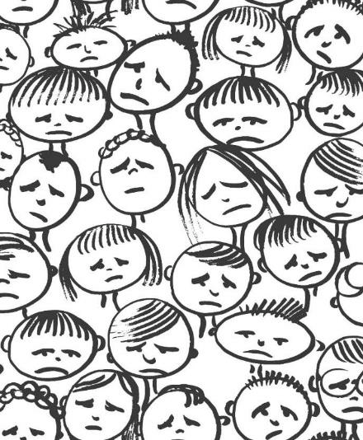
Why Bother with Theory?
“Theory is boring… I want to help people!”
Batik from 123rf
www.cswe.org
Notes:
Presenter
2021-05-12 14:11:59
--------------------------------------------
So, you might be wondering why social workers bother with theories of substance misuse when all we really want to do is to help people experiencing substance-related problems or prevent these problems from developing in the first place. How will knowing theories, especially so many different theories, help you make a difference in the real world?

Slide 4
theory
informs
intervention
www.cswe.org
Notes:
Presenter
2021-05-12 14:11:59
--------------------------------------------
One major reason for studying theories is to inform our interventions for helping people get past and recover from problems with substance misuse, how to prevent people from getting into trouble with substance misuse in the first place, how to prevent use of alcohol or other drugs from becoming a substance use disorder, and how to make families, schools, workplaces, neighborhoods, communities, and our world in general healthier places to live and grow.
When we apply a solution to address an alcohol or other substance-related problem, that solution is based on a set of assumptions, theories, or models concerning how the problem came to be, what factors and mechanisms contribute to the problem emerging and maintain or sustain its existence, and what might reasonably be expected if we intervene to change or manipulate those influencing factors.
Theory and the evidence supporting our theories or models provide a blueprint to guide our intervention efforts.
Social workers prefer our intervention efforts to be informed by theory and evidence rather than taking random chances with people’s lives.
The trick is that there exist many relevant theories and models related to substance misuse for us to consider—this presentation provides a general orientation and structure for understanding them—you will need to develop a deeper understanding as you continue learning to practice in the area of substance use, substance misuse, substance use disorders, and recovery.

Slide 5
OUTLINE
➢Biopsychosocial Framework
➢Biological Influencer & Effect Models
➢Psychological Influencer & Effect Models
➢Social Context and Physical Environment & Circularity of Influence Models
➢Theory (re)Integration
➢Generalized vs Specific Models
www.cswe.org
Notes:
Presenter
2021-05-12 14:11:59
--------------------------------------------
The theories and models presented align reasonably well within a biopsychosocial framework.
Once the framework has been outlined, we identify several biological theories and models relevant to substance misuse, use disorders, and recovery.
Then we identify quite a few theories and models within the psychological domain, and another set that fall within the social context and physical environment domain. In this context, the circularity of influence model is briefly explored. This is followed by a brief discussion that gets back to a more integrated biopsychosocial framework, especially as it might inform prevention strategies.
A final topic is introduced as it relate to substance misuse theories and models—how we might think differently about generalized versus specific models concerning different types of substances.

Slide 6
BIOPSYCHOSOCIAL
biological
psychological
social & physical contexts
(see Begun, 2019)
www.cswe.org
Notes:
Presenter
2021-05-12 14:11:59
--------------------------------------------
In terms of multiple theories for understanding substance use, similarities, differences, and important points of intersection exist. The biopsychosocial framework provides an organizing framework to clarify what otherwise might seem like a jumble of ideas. This framework suggests two important things:
First, biology, psychology, social and physical context domains are each important in understanding the processes related to substance misuse and recovery. Some scholars and clinicians add the spiritual as an additional domain, but for purposes of this presentation, spirituality is integrated in the social and physical contexts domain.

Slide 7
BIOPSYCHOSOCIAL
social & physical contexts
_{X} psychological X
biological
(see Begun, 2019)
www.cswe.org
Notes:
Presenter
2021-05-12 14:12:00
--------------------------------------------
Second, the biopsychosocial framework emphasizes interactions and relationships between these 3 domains—these 3 domains do not operate as independent silos. They intersect, overlap, and interact in meaningful and synergistic ways.
For example, consider the ways that the neurobiology of learning interacts with psychological learning processes to produce the often-observed cue-induced triggers or cravings. Or, for example, consider the ways that spirituality crosses boundaries between social & physical contexts where we placed it and psychological and biological influences, as well. The mechanisms by which mindfulness practices support recovery demonstrate this kind of integration across domains. One point that all the evidence indicates is that there exists no one single cause of substance misuse and substance use disorders; there is not even one single domain involved. Substance misuse, substance use disorders, and recovery are very complex phenomena influenced by multiple interacting factors.
This is one reason why it can be so different an experience for different individuals, and why “one size fits all” solutions simply don’t---they don’t fit all.

Slide 8
INFLUENCES
➢genetics
➢early brain exposure
➢pain
EFFECTS
➢possible SUD
➢organ systems
➢infectious disease
➢unplanned pregnancy
➢injury
BIOLOGICAL
(see Bares & Chartier, 2020; Begun, 2019; Brooks et al, 2009;
Maimaris & McCambridge, 2014; Vakharia & Little, 2020; White & Koob, 2020)
www.cswe.org
Notes:
Presenter
2021-05-12 14:12:00
--------------------------------------------
In the biological domain, we are interested in the ways that different biological factors might influence a person’s substance use initiation and their substance use becoming substance misuse or a substance use disorder. On the flip side, we are also concerned with how substance misuse might affect a person’s biology and physical health—assumed in all of these discussions about possible effects is the possibility of developing a substance use disorder. Together, we want to know how to intervene at a biological level to prevent substance use disorders and to support recovery.
An additional point related to effects of substance misuse concerns how this information can help inform harm reduction efforts—these are interventions aimed at reducing the probability and severity of many different potential harms arising from substance misuse even when reducing substance misuse itself is not the immediate goal.

Slide 9

INFLUENCES
➢genetics
➢early brain exposure
➢pain
EFFECTS
➢possible SUD
➢organ systems
➢infectious disease
➢unplanned pregnancy
➢injury
BIOLOGICAL
(see Bares & Chartier, 2020; Begun, 2019; Brooks et al, 2009; Maimaris & McCambridge, 2014; White & Koob, 2020)
9
www.cswe.org
Notes:
Presenter
2021-05-12 14:12:00
--------------------------------------------
Starting with biological mechanisms that affect substance misuse and substance use disorders, genetic influence models have piled up a great deal of evidence. For example, evidence supports a model of genetic contributions to a person first initiating use of nicotine containing substances like cigarettes and vaping. A great deal of evidence points to genetic links in the transition from alcohol misuse to an alcohol use disorder—a compilation of evidence from twin, adoption, family pedigree, and genomic studies.
Genetics contribute to positive, protective mechanisms, as well—not just vulnerability. For example, there is a genetic basis to some individuals experiencing an intensely negative flushing response to alcohol. This punishing physiological response potentially protects a person from engaging in alcohol use in the future. An estimated 36% of persons of East Asian genetic background experience intense facial flushing, nausea, and rapid heart rate in response to alcohol exposure because of the genetics behind their ability to break down alcohol metabolism byproducts.
Jumping briefly to the effects topic, this genetic mechanism also makes individuals more susceptible to alcohol-related cancers, as well, because it operates by extending the time and concentration of exposure to damaging alcohol breakdown metabolites in the body.

Slide 10
Family Tree
X X
(Genogram)
X
X
X
X
X=deceased
female
male
red=positive for AUD/SUD
10
www.cswe.org
Notes:
Presenter
2021-05-12 14:12:00
--------------------------------------------
Back to genetic influences, considerable evidence exists for a genetic contribution to alcohol as well as other forms of substance use disorder. But the most important of all take home lessons is that genetic influences interact with other biological, psychological, and social context mechanisms: genetics alone do not determine a person’s destiny—outcomes are quite variable depending on a whole complex of factors involved. For example, looking at an individual person’s pedigree or family tree, it is impossible to fully separate the genetic pattern from the social and physical environment influences—just because the child of a person with a substance use disorder also develops a substance use disorder does not mean that the transmission from one generation to the next was strictly genetic—other family and social or physical context forces may be involved.

Slide 11

INFLUENCES
➢genetics
➢early brain exposure
➢pain
EFFECTS
➢possible SUD
➢organ systems
➢infectious disease
➢unplanned pregnancy
➢injury
BIOLOGICAL
(see Bares & Chartier, 2020; Begun, 2019; Brooks et al, 2009; Maimaris & McCambridge, 2014; White & Koob, 2020)
www.cswe.org
Notes:
Presenter
2021-05-12 14:12:00
--------------------------------------------
Additional biological mechanisms beyond genetics warrant attention. For example, exposure to alcohol or certain other substances at critical periods of brain development may influence a person’s susceptibility to or probability of developing a specific substance use disorder later in life. In the case of alcohol exposure, evidence indicates that drinking before age 15 was associated with a 4 times greater rate of alcohol dependence during adulthood than was observed among adults who did not drink before the age of 21 years. Plausibly, this is related to disruption of the normative developmental brain changes occurring during adolescence. The differences may also be attributed to personality differences between individuals who begin drinking early and those who delay initiation—personality differences which may result from genetic and early biological influences on temperament. The impact on adolescent and adult substance use patterns related to prenatal brain exposure to various substances is also a question explored through research.

Slide 12
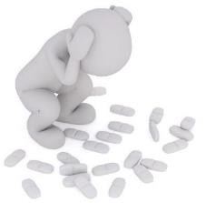
INFLUENCES
➢genetics
➢early brain exposure
➢pain
EFFECTS
➢possible SUD
➢organ systems
➢infectious disease
➢unplanned pregnancy
➢injury
BIOLOGICAL
(see Bares & Chartier, 2020; Begun, 2019; Brooks et al, 2009; Maimaris & McCambridge, 2014; White & Koob, 2020)
www.cswe.org
Notes:
Presenter
2021-05-12 14:12:00
--------------------------------------------
For another biological influence model, consider that individuals experiencing chronic severe physical pain may be prescribed opioid medications to help manage their pain, which could result in development of an opioid use disorder over time. However, opioid misuse can also have the effect of lowering of a person’s pain threshold or pain tolerance which might also influence opioid misuse once initiated.

Slide 13

INFLUENCES
➢genetics
➢early brain exposure
➢pain
EFFECTS
➢possible SUD
➢organ systems
BIOLOGICAL
➢infectious disease
➢unplanned pregnancy
➢injury
(see Bares & Chartier, 2020; Begun, 2019; Brooks et al, 2009; Maimaris & McCambridge, 2014; White & Koob, 2020)
www.cswe.org
Notes:
Presenter
2021-05-12 14:12:00
--------------------------------------------
Turning to how substance misuse affects a person’s biology and physical health, we have at least 3 areas of concern for theory to address. First, there exists considerable evidence about different substances and their specific effects on the human body’s organs and organ systems. This includes the association of substance misuse with a number of non-communicable disease states—such as diabetes, cancers, high blood pressure, cardiac problems, and others. For example, we know that chronic heavy alcohol consumption has harmful effects on the brain, heart, liver, pancreas, immune system, and multiple forms of cancer. Similarly, we know a great deal about the negative physical health effects of smoking tobacco products and are learning about the effects of vaping, too. Less is understood about potential long-term effects of heavy cannabis use.
We also know that alcohol, tobacco, opioids, cocaine, barbiturates and other substances can have negative effects on a developing fetus if used during pregnancy.

Slide 14

INFLUENCES
➢genetics
➢early brain exposure
➢pain
EFFECTS
➢possible SUD
➢organ systems
BIOLOGICAL
➢infectious disease
➢unplanned pregnancy
➢injury
(see Bares & Chartier, 2020; Begun, 2019; Brooks et al, 2009; Maimaris & McCambridge, 2014; White & Koob, 2020)
www.cswe.org
Notes:
Presenter
2021-05-12 14:12:00
--------------------------------------------
Substance misuse and associated behaviors surrounding substance misuse may increase a person’s potential exposure to infectious diseases, including sexually transmitted diseases, as well as unplanned pregnancy. For example, sex-for-drugs exchanges are an associated behavior of concern. Or, for example, shared or re-used needles with injection drug use potentially exposes a person to infection at the injection site and other blood-borne infections such as HIV and hepatitis. Reducing these public health risks is one aim of clean needle, syringe services, harm reduction programs. Additionally, substance misuse and associated behaviors may reduce a person’s resistance to infectious diseases—they may become more seriously ill if they do become infected.

Slide 15

INFLUENCES
➢genetics
➢early brain exposure
➢pain
EFFECTS
➢possible SUD
➢organ systems
➢infectious disease
➢unplanned pregnancy
BIOLOGICAL
➢injury
(see Bares & Chartier, 2020; Begun, 2019; Brooks et al, 2009; Maimaris & McCambridge, 2014; White & Koob, 2020)
www.cswe.org
Notes:
Presenter
2021-05-12 14:12:00
--------------------------------------------
Third, many psychoactive substances affect coordination, mood, judgement, memory, information processing, motivation, and other cognitive functions. For example, according to the World Health Organization, about ½ of the world’s 1.8 million deaths attributable to alcohol are from either unintentional or intentional injuries, including suicide, assaults, and falls. And, as previously noted in the discussion about pain, injuries can result in chronic pain that contributes to substance misuse.

Slide 16
INFLUENCES
➢genetics
➢early brain exposure
➢pain
EFFECTS
BIOLOGICAL
➢Possible SUD
➢organ systems
➢infectious disease
➢unplanned pregnancy
➢injury
(see Bares & Chartier, 2020; Begun, 2019; Brooks et al, 2009; Maimaris & McCambridge, 2014; White & Koob, 2020)
www.cswe.org
Notes:
Presenter
2021-05-12 14:12:00
--------------------------------------------
Thus, it is critical to understand biological factors if we are to understand and effectively intervene around substance misuse. For example, understanding the biology of substance misuse and substance use disorders has contributed to the development of various mindfulness based and pharmacotherapy strategies for supporting individuals in recovery.

Slide 17
INFLUENCES & EFFECTS
➢Psychological Systems
cognition & information processing
affect
➢Psychoanalytic, Psychodynamic,
& Attachment Theory
➢Personality Theory
➢Learning Theory
➢Social Learning Theory
➢Cognitive Theories
➢Developmental Theories
➢Self-Medication Theory
PSYCHOLOGICAL
(see Begun, 2019; 2020b)
www.cswe.org
Notes:
Presenter
2021-05-12 14:12:00
--------------------------------------------
Now let’s move into the psychological theories domain. The list of psychological theories and models to consider is both long and varied.
When we talk about understanding psychological processes, we are generally talking about the way that people think and feel—we are not just interested in WHAT they think and feel, we are also interested in the mechanisms by which thinking and feeling operate.

Slide 18

INFLUENCES & EFFECTS
➢Psychological Systems
cognition & information processing
affect
➢Psychoanalytic, Psychodynamic,
& Attachment Theory
➢Personality Theory
➢Learning Theory
➢Social Learning Theory
➢Cognitive Theories
➢Developmental Theories
➢Self-Medication Theory
PPSSYYCCHHOOLOOGGICICAALL
(see Begun, 2019; 2020b)
www.cswe.org
Notes:
Presenter
2021-05-12 14:12:00
--------------------------------------------
Cognition is about thinking and thought processes. This includes how we take in information, how we learn, our learning styles, how we manipulate information and ideas, how we understand the world around us and understand our experiences, our problem-solving approaches, what we remember and how we remember it. There is absolutely no doubt that cognition and cognitive processes are integrally entwined with biological processes, as well as being integrally entwined with substance use disorders.

Slide 19
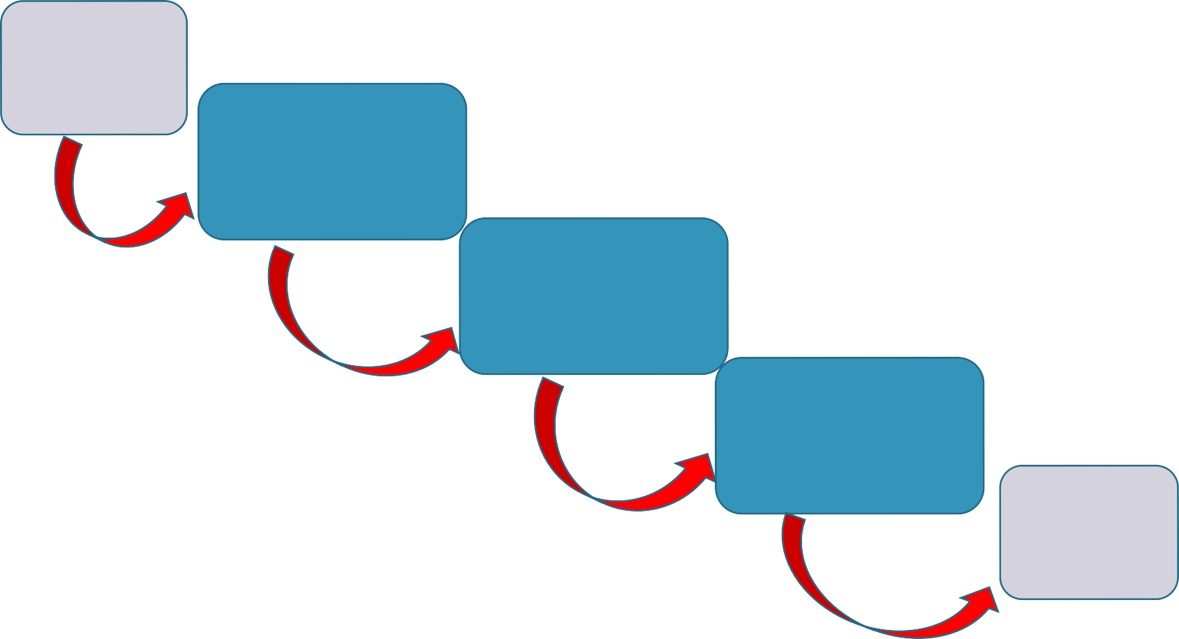
Information Processing
Stimulus/ event
Input/ perception
Storage/ memory
Retrieval/ recall
Output/ Behavior
(see Begun,2019; 2020b)
Notes:
Presenter
2021-05-12 14:12:00
--------------------------------------------
The very nature of psychoactive substances is that they affect the way a person experiences the world, thinks, and behaves. Thus, it is important to consider how information processing theories relate to substance use and misuse. Information processing is about what happens between a stimulus event and the behavior a person exhibits in response to that stimulus.
First in an information processing model, many types of substances have an impact on perception—the way any of a person’s five senses receive input information, and also perception of their own internal bodily states—for example, pain perception. Or, for example, you may have noticed that social gatherings get louder as alcohol is consumed. This is, in part, because increasing alcohol levels dampen a person’s hearing acuity, so they overcompensate with increased speaking and music volume.
Next in the information processing model is memory—how perceived information becomes stored in memory. Many different types of substances affect how perceived information is transferred into short- and long-term memory—some may even cause a form of amnesia whereby no memory for an event is ever formed—“date rape drugs” for instance. In addition to these immediate short-term memory distortions, chronic and heavy use of certain substances may damage areas of the brain where long-term memories are stored. Then there is the influence substances may have on a person’s ability to retrieve or recall certain memories. For example, a person may find it difficult to remember information or how to perform a skill that was learned under the influence of heavy alcohol use when trying to recall it without alcohol in their system—a concept called state dependent learning. A person need not progress to the point of alcohol blackout to have difficulty with memory retrieval or recall for events while drinking heavily.
Together these steps in information processing helps explain why individuals might behave very differently when they engage in substance use compared to when they do not.

Slide 20
INFLUENCES & EFFECTS
➢Psychological Systems
cognition & information processing
affect
➢Psychoanalytic, Psychodynamic,
& Attachment Theory
➢Personality Theory
➢Learning Theory
➢Social Learning Theory
➢Cognitive Theories
➢Developmental Theories
➢Self-Medication Theory
PPSSYYCCHHOOLOOGGICICAALL
(see Begun, 2019; 2020b)
www.cswe.org
Notes:
Presenter
2021-05-12 14:12:01
--------------------------------------------
Another psychological aspect concerns feelings. Emotions. Our affect.
How we label our feelings has a lot to do with how we respond when we experience them—this is a link between affect and cognition. If we interpret or label a situation as calling for us to feel “mad” or “sad” or “bad” or even “glad” we have developed certain types of responses to these emotions. If substance use was the response developed to any of these feelings, then we are likely to use that as a response again when we feel them in the future. By the way, how did YOU interpret the screen bean character on this slide? Is this character running forward to joyously hug someone, feeling glad? Or, is this a case of running away from something scary, feeling panicked or fearful? Or is it an expression of extreme frustration and throwing their hands up in the air?
So, you see how the way we cognitively interpret a situation has a lot to do with how we behave.

Slide 21
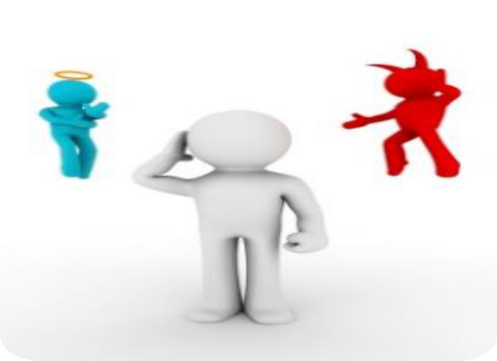

INFLUENCES & EFFECTS
➢Psychological Systems
cognition & information processing
affect
➢Psychoanalytic, Psychodynamic
& Attachment Theory
➢Personality Theory
➢Learning Theory
➢Social Learning Theory
➢Cognitive Theories
➢Developmental Theories
➢Self-Medication Theory
PSYCHOLOGICAL
(see Begun, 2019; 2020b)
www.cswe.org
Notes:
Presenter
2021-05-12 14:12:01
--------------------------------------------
In psychoanalytic and psychodynamic theory, addictive behavior is a symptom of intra-psychic conflict or unresolved psychological tension and turmoil. This is where the concept of Id, Ego, and Super-Ego come into play.
The Id presents choices for responding to our urges and raw emotions. The choice of using alcohol or cannabis or other substances is a possible response to intense negative emotions—allowing a person to escape or numb those intensely uncomfortable feelings.
Through experiences with the social environment the Super-Ego develops a commitment to behavior that is acceptable in the person’s social world. The Super-Ego editorializes about choices the Id has hatched—for example, self-shaming about one’s own substance use. A considerable degree of tension develops between the two forces or “wills” the person experiences. Some individuals describe their experience as actual voices they hear inside their mind, arguing with each other and sending them shaming and blaming messages.
The Ego develops as the manager over this miserable tension between the Id and Super-Ego—the Ego serves as a referee between the strong urges to behave in certain ways coming from the Id and the strong pressure not to behave in those ways coming from the Super Ego. The decision to use substances like alcohol, cannabis, and some other psychoactive substances is sometimes a solution to silence the Super Ego, putting it to sleep, not only to satisfy the Id’s desire to remove the unpleasant emotional experience, but also to remove the unpleasant, tension-filled experience of the conflict between Id and Super-Ego. Substances might be misused in an attempt to quiet the loud, negative voices inside the mind.

Slide 22

INFLUENCES & EFFECTS
➢Psychological Systems
cognition & information processing
affect
➢Psychoanalytic, Psychodynamic
& Attachment Theory
➢Personality Theory
➢Learning Theory
➢Social Learning Theory
➢Cognitive Theories
➢Developmental Theories
➢Self-Medication Theory
PSYCHOLOGICAL
(see Begun, 2019; 2020b)
www.cswe.org
Notes:
Presenter
2021-05-12 14:12:01
--------------------------------------------
Yet another psychoanalytic interpretation of addictive behavior, particularly for smoking tobacco, cannabis, or vaping products, is related to the concept of oral fixation.
In psychoanalytic theory, it is part of the normative course of development that a person’s libidinal energies become localized at a specific zone of the body at different periods of development. Libido does not only refer to a person’s sexual drive—earlier in development, libidinal energies localize in the oral zone—around the mouth. Stimulation of the oral zone feels good because it relieves the tension in that area caused by the localized libido. Orality is a period of infancy—we expect to see babies using their mouths to explore the world. According to psychoanalytic theory, if something happens at this early orality phase of development to trap some of the libido in the oral zone, the person will spend a lifetime trying to satisfy the need for oral stimulation—putting things in the mouth, chewing or sucking on things—like cigarettes, cigars, or even vaping units.
In this theory, these oral behaviors are viewed as an effort to curb the demands from the trapped libido. Logically, a person should be able to substitute one oral tool for another—in other words, chewing gum or drinking from water bottles should be able to resolve a need to smoke. It is not so simple, though—the cigarettes, cigars, or vaping tools come to cause demands of their own from the chemicals involved.

Slide 23

INFLUENCES & EFFECTS
➢Psychological Systems
cognition & information processing
affect
➢Psychoanalytic, Psychodynamic
& Attachment Theory
➢Personality Theory
➢Learning Theory
➢Social Learning Theory
➢Cognitive Theories
➢Developmental Theories
➢Self-Medication Theory
PSYCHOLOGICAL
(see Begun, 2019; 2020b)
www.cswe.org
Notes:
Presenter
2021-05-12 14:12:01
--------------------------------------------
Infants and young children, in the normative course of development, form attachment relationships with caregivers central to their physical and emotional survival—parents, siblings, caregivers, even pets and some special “objects” (like a blankie or stuffed animal). These psychological attachments are what allow us to have the sense of security in a great big, unpredictable world.
Sometimes, attachment relationships are disrupted. They fail to form at all, they are broken once formed, or they form as insecure and unstable attachments. According to attachment theory, a person with attachment issues is likely to experience significant “holes” in their emotional and personality development. The world does not seem like a safe, predictable, reliable place, nor are there safe and predictable people on whom the person can rely. Sometimes these individuals describe themselves as being “full of emptiness.” Such a person may come to rely on alcohol or other drugs as a means of coping with the pain and loneliness of these holes and gaps. Substance use might “numb” the psychic pain and sense of detachment. And the drinking or drug-taking social environment itself may be what they use to fill the emptiness inside—it is not necessarily the alcohol or drugs but the drinking or drug-taking situations that start the pattern, but if it progresses, the drugs or alcohol began to place their own demands on the person.
The intervention implications related to psychoanalytic, psychodynamic, and attachment theory models of substance misuse are that the original sources of conflict, loss, or other disruptions need to be identified and resolved—therapies that repair the psychic damage, help the person become whole and fill the empty voids. This is the therapeutic goal of many forms of psychotherapy and individual counseling approaches. The preventive strategy is to help create developmental contexts, including early infancy and childhood, where the person is psychologically nurtured.

Slide 24

INFLUENCES & EFFECTS
➢Psychological Systems
cognition & information processing
affect
➢Psychoanalytic, Psychodynamic,
& Attachment Theory
© Aлeнa Mapyceвa
➢Personality Theory
PSYCHOLOGICAL
➢Learning Theory
➢Social Learning Theory
➢Cognitive Theories
➢Developmental Theories
➢Self-Medication Theory
(see Begun, 2019; 2020b; Fehrman et al, 2019)
www.cswe.org
Notes:
Presenter
2021-05-12 14:12:01
--------------------------------------------
You may have heard about the concept of an addictive personality. The idea is that someone’s personality characteristics make them likely to initiate substance use or to develop a substance use disorder once use is initiated. These days, the idea of an addictive personality is considered somewhat out-of-date as it is not well supported by evidence.
The idea is challenged by recognizing that there are no specific personality characteristics that all people engaging in addictive behavior share in common. Another challenge is that traits or characteristics that have been identified as common among individuals engaging in addictive behavior are not unique to this population—others share those traits, too.
The evidence indicates that pretty much any person can develop a substance use disorder if the right (or, in this case the wrong) circumstances come together. Some personality types may be more vulnerable or at a higher risk of developing certain types of substance use disorders, but the potential is there for anyone. For example, a Five Factor Model (Plus Two) suggested that neuroticism, extraversion, openness to novel experiences, impulsivity and sensations seeking, combined with low agreeableness and conscientiousness predicted use of psychoactive substances. There is a great deal of correlational data suggesting that certain traits are more commonly associated with substance use initiation, substance misuse, and substance use disorder. But, correlation does not demonstrate causality—substance misuse could just as likely be the cause of changes in personality or some third factor could be the root of both the substance misuse and the personality traits. Thus, there remains a great deal of controversy as to the existence of a generalizable addictive personality type. In other words, a person experiencing a substance use disorder is not a separate type of person!
Consider what might be the intervention implications of personality influences on substance misuse—it might help with early identification of persons who might be most vulnerable, but what would it suggest we actually DO about it? Changing personality is a very difficult challenge.

Slide 25

INFLUENCES & EFFECTS
➢Psychological Systems
cognition & information processing
affect
➢Psychoanalytic, Psychodynamic,
& Attachment Theory
➢Personality Theory
PSYCHOLOGICAL
➢Learning Theory
➢Social Learning Theory
➢Cognitive Theories
➢Developmental Theories
➢Self-Medication Theory
(see Begun, 2019; 2020b)
www.cswe.org
Notes:
Presenter
2021-05-12 14:12:01
--------------------------------------------
A great deal of evidence surrounds the psychological and neurobiology basis of learning related to substance use evolving into a substance use disorder. Reinforcement and punishment principles form the basis of operant conditioning learning models and help explain how specific and general substance use behaviors are shaped and then maintained once initiated. Classical conditioning helps explain the way that substance use and misuse behavior is maintained once certain stimuli have become paired with substance use through this learning paradigm. This learning theory explains the experience of cue-reactivity or cue-induced craving triggers—intense desires to engage in substance use again being triggered by encountering paired stimuli. These craving experiences pose a threat to a person’s recovery efforts. Closely tied to these learning principles, social learning theory also contributes to an understanding of how substance use or misuse behavior is initially acquired and then possibly maintained. A person’s social world is the source of many types of reinforcement and punishment for substance use and misuse relevant to learning through operant conditioning. Additionally, observational learning is a phenomenon identified in social learning theory. This model reflects on the many different behavioral models to which a person is exposed in their social context—models whose behavior the person might choose to imitate.
These learning theories inform a variety of intervention strategies. For example, cue exposure therapy is designed to systematically desensitize a person to their cue-induced triggers and may be supported by coping skills training to help a person respond in healthful ways when craving is triggered. Or, for example, the community reinforcement approach to treating alcohol and other substance use disorders is based on operant conditioning principles. Prevention strategies often employ models of healthful behavior in recognition of observational learning as a powerful influence on behavior.

Slide 26

INFLUENCES & EFFECTS
ic,
➢Psychological Systems
cognition & information processing
affect
➢Psychoanalytic, Psychodynam
& Attachment Theory
➢Personality Theory
➢Learning Theory
PSYCHOLOGICAL
➢Social Learning Theory
➢Cognitive Theories
➢Developmental Theories
➢Self-Medication Theory
(see Begun, 2019; 2020b)
www.cswe.org
Notes:
Presenter
2021-05-12 14:12:01
--------------------------------------------
Cognitive theories inform a great many evidence-supported interventions for addressing alcohol, tobacco, and other substance misuse or use disorders. These include cognitive behavioral therapies, or CBT, and cognitive behavioral coping skills training interventions, or CBCST.
The theories relate to how behavior follows from how a person interprets an event or experience. The nature of the interpretation determines a response. Thus, it might be helpful to either intervene to help someone interpret the experience differently—leading to a different behavioral response—and/or to prepare the person with new responses to the experience as interpreted.

Slide 27



danger
cognitive assessment
behavioral outcome
©A. Begun
stimulus
awesome
(see Begun, 2019; 2020b)
www.cswe.org
Notes:
Presenter
2021-05-12 14:12:02
--------------------------------------------
Here is a simple example cognition is relevant:
2 different ways of interpreting the experience of encountering a grizzly bear in the wild.
If it is interpreted as dangerous, the reasonable response might be to escape, to run away.
If, on the other hand, it is interpreted as awesome, the response might be to take a photograph.

Slide 28

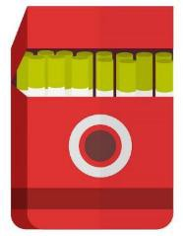

“Here, have one of mine…”
risk
cognitive assessment
behavioral outcome
rewarding
stimulus
(see Begun, 2019; 2020b)
www.cswe.org
Notes:
Presenter
2021-05-12 14:12:02
--------------------------------------------
In relation to substance use, we could put any of a number of experiences in the stimulus box—being offered a cigarette, cannabis, vaping device, drink or other drug is only one possibility.
How a person assesses or interprets the offer determines their behavioral response—whether they accept the offer or decline. In this example, whether they end up smoking or not. Perceived as risky, the person might not accept the smoke. Perceived as rewarding, making someone feel good, they might accept and smoke. So, as previously discussed this cognitive model relates to a host of recovery support and treatment interventions.

Slide 29

Expectancies
Positive
Negative
Encourages
Discourages
(see Jester et al, 2015; Kristjansson, Agrawal, Lynskey, & Chassin, 2012)
www.cswe.org
Notes:
Presenter
2021-05-12 14:12:02
--------------------------------------------
An important aspect of a person’s cognitions about alcohol and other substance use concerns their expectancies about the positive or negative effects of using those substances. In that middle step of appraisal, between the stimulus and the behavioral outcome, expectancies influence appraisal, hence the behavioral outcomes. Positive expectancies promote substance use and negative expectancies have am opposite effect. Expectancies are shaped by direct personal experience and interactions with the social and physical environment—family, peers, media, and advertising for example. For example, having an expectancy that using cannabis will make you feel happy and relaxed influences your appraisal and choice about using cannabis when the opportunity arises. On the other hand, having an expectancy that using cannabis makes you dull-witted and impairs your reflexes may influence your appraisal differently, leading to a different behavioral outcome. Expectancies are a powerful risk factor for heavy alcohol use, have demonstrated effect on use of cannabis products, and may very well operate in the misuse of other substances.
Evidence exists that alcohol expectancies develop among early school aged children and that childhood expectancies predict how early in life someone first becomes drunk and when they begin to engage in binge drinking. Expectancies are further shaped by these early drinking experiences, as well.

Slide 30

INFLUENCES & EFFECTS
➢Psychological Systems
cognition & information processing
affect
➢Psychoanalytic, Psychodynamic,
& Attachment Theory
➢Personality Theory
➢Learning Theory
➢Social Learning Theory
PSYCHOLOGICAL
➢Cognitive Theories
➢Developmental Theories
➢Self-Medication Theory
(see Begun, 2019; 2020b; Koob, n.d.)
30
www.cswe.org
Notes:
Presenter
2021-05-12 14:12:02
--------------------------------------------
Our next topic is developmental theories or models. These come in two forms—one having to do with an effort to map a common developmental course or trajectory of substance use disorders and the other related to how substance use and misuse intersect with the course of individual lifecourse development. An example of the first is a 3-stage model of addiction beginning with binge use and intoxication, evolving into withdrawal and negative affect, and capped with preoccupation, anticipation, and craving.

Slide 31
Stages of Change
(Transtheoretical Model of Behavior Change)
Maintenance Preparation/Action
Contemplation
Precontemplation
(see Begun, 2019; Prochaska, DiClemente, & Norcross, 1992)
31
www.cswe.org
Notes:
Presenter
2021-05-12 14:12:02
--------------------------------------------
Other examples of stage models related to the progression from substance use to developing a substance use disorder include the natural history of alcoholism proposed by Jellinek in the 1950s and 1960s and expanded upon by other scholars since then. The original Jellinek model progressed in 4 phases between the prealcoholic, prodromal, crucial, and chronic phases. These kinds of theories reflect a belief that a common trajectory to addiction or substance use disorder exists.
On the other hand, the stages of change element of a Transtheoretical Model of Behavior Change proposes that there exists a spiral-shaped developmental progression to the recovery process, as well. Individuals engaged in substance misuse or experiencing a substance use disorder may first have no plan to make change in their behavior. At some point, they may begin to recognize that a problem exists and begin to consider not only the need to make changes but consider ways that change might be achieved. Subsequently, a person may begin to make concrete preparations to change and then engage in specific actions to achieve a change goal. Eventually, they may achieve a new state where the change in now the new normal behavior and they engage in efforts to maintain the hard-won changes. The spiral notion comes into play in that people commonly move up and down in this sequence, not necessarily in a single direction. One implication of this model is that we need to implement different types of interventions matched to each of the different stages.

Slide 32
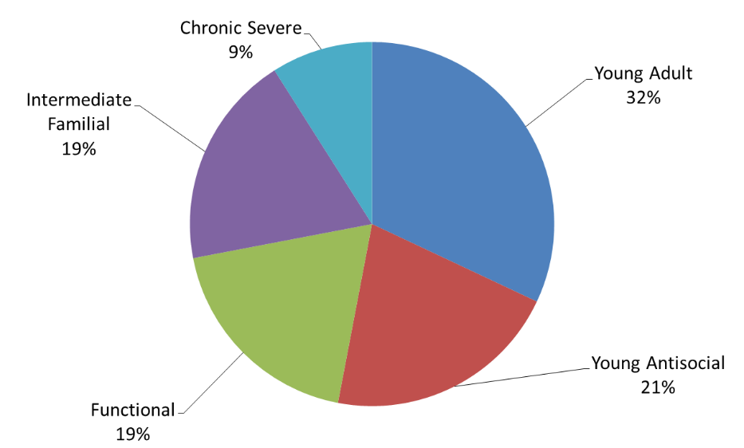
(see Moss, Chen, & Yi, 2007)
32
www.cswe.org
Notes:
Presenter
2021-05-12 14:12:02
--------------------------------------------
Still other scholars argue instead of there being a single developmental trajectory, for instance from functional to chronic severe disorders. The argument is that there exists a typology of different ways that substance use disorders manifest. This pie chart represents results of a re-analysis of data from the National Epidemiological Survey on Alcohol and Related Conditions, NESARC for short. The authors identified five clusters or subtypes of individuals who met criteria for and alcohol use disorder and argued that these subtypes are qualitatively different and do not fall on a developmental continuum.

Slide 33
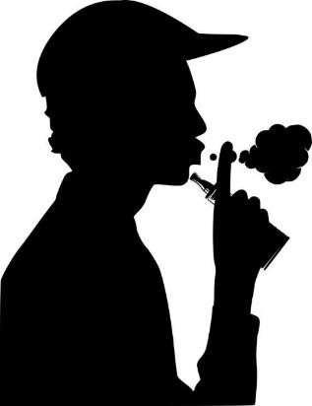

Behavioral Under-Control
(see Begun, 2019)
33
www.cswe.org
Notes:
Presenter
2021-05-12 14:12:02
--------------------------------------------
In addition to developmental trajectory models, another whole type of developmental model exists. These models address the intersection between human developmental processes and substance misuse. For example, behavioral under-control theory explains why individuals might be more susceptible to engaging in substance misuse during adolescence than other developmental periods. It draws on biological models of adolescent brain development involving functional revisions to areas responsible for inhibiting behavior lagging behind changes in areas responsible for initiating behavior. As a result, adolescents exhibit behavioral under-control, meaning that they are more likely to engage in risky behavior, playing with fire so to speak. The drive to “act” is under-controlled by inhibitory forces. Behavioral under control, in the course of normative development, eventually becomes replaced by greater inhibitory control and better judgment influencing behavior.

Slide 34

PREVALENCE OF LIFETIME DRUG DEPENDENCE
prevalence lifetime drug dependence
40
DIAGNOSIS BY AGE AT FIRST DRUG USE
35
33.6
30
26.8
25.4
25
20
17.7
15.1
15
15
13.4
13.6
11.4
10
5
0
13-
14
15
16 17 18
age at first drug use
19
20
21+
(see Grant & Dawson, 1998)
www.cswe.org
Notes:
Presenter
2021-05-12 14:12:02
--------------------------------------------
Here is another example of the second form of developmental model. The evidence presented on this slide depicts data from the first wave of the National Epidemiologic Survey on alcohol and related conditions, called NESARC for short.
The graph demonstrates that the prevalence of meeting criteria of a drug dependence disorder during a person’s lifetime (using DSM-IV criteria of the time) is related to the age at which drug use was first initiated. The prevalence of a lifetime substance use disorder was greatest among individuals whose drug use began at or before age 13 – up there on the left at 33.6-- and that it dropped pretty steadily across adolescence and emerging adulthood. Prevalence among individuals whose drug use initiation was delayed to age 20 was down to 11.4 and 13.6 for those who waited until age 21 or older. All of these developmental theories and models have implications for prevention, early intervention, and recovery support.

Slide 35

INFLUENCES & EFFECTS
➢Psychological Systems
cognition & information processing
affect
➢Psychoanalytic, Psychodynamic,
& Attachment Theory
➢Personality Theory
➢Learning Theory
➢Social Learning Theory
➢Cognitive Theories
PSYCHOLOGICAL
➢Developmental Theories
➢Self-Medication Theory
(see Begun, 2019; 2020b)
www.cswe.org
Notes:
Presenter
2021-05-12 14:12:02
--------------------------------------------
While there remain other psychological theories and models to consider, we’ll wrap up our discussion of psychological models with self-medication theory. This is closely entwined with what is recognized as an association between trauma and substance use, misuse, and use disorders. A great deal of evidence illustrates a high concordance between trauma and substance misuse and substance use disorders—trauma related to adverse childhood events, or ACES, and trauma occurring during later developmental periods, including trauma related to military service experiences, intimate partner violence, sexual assault, and other life and limb threatening experiences. According to self-medication theory, individuals may seek to medicate their psychological pain, anxiety, grief, and depression with alcohol or other substances. It also suggests that individuals with attention deficit disorder and other mental disorders may be doing the same—attempting to treat themselves with psychoactive substances. An obvious implication for intervention is that these individuals be supported in addressing and managing their underlying trauma and psychological concerns with evidence-supported interventions instead and that substance use disorders emerging from their efforts at self-medication be addressed, as well.

Slide 36
INFLUENCES & EFFECTS
➢Psychological Systems
cognition & information processing
affect
➢Psychoanalytic, Psychodynamic,
& Attachment Theory
➢Personality Theory
PSYCHOLOGICAL
➢Learning Theory
➢Social Learning Theory
➢Cognitive Theories
➢Developmental Theories
➢Self-Medication Theory
(see Begun, 2019; 2020b)
www.cswe.org
Notes:
Presenter
2021-05-12 14:12:03
--------------------------------------------
Thus, it is critical to understand psychological factors if we are to understand and effectively intervene around substance misuse. For example, understanding the psychology of substance misuse and substance use disorders has contributed to the development of multiple behavioral and counseling strategies for supporting individuals in recovery.

Slide 37
INFLUENCES & EFFECTS
➢Ecological Systems Theory
➢Family Systems Theory
➢Access/Physical Environments
➢Social Norms Theory
➢Social Justice
SOCIAL & PHYSICAL CONTEXTS
(see Begun, 2019; Begun, Bares, & Chartier, 2020)
www.cswe.org
Notes:
Presenter
2021-05-12 14:12:03
--------------------------------------------
This brings us to the 3rd and final domain of a biopsychosocial perspective on substance misuse—what is going on in the social context and physical environment, and here we include spiritual factors, as well. There exist many more theories and models addressing social and physical context factors than presented in this list; this is just a start.

Slide 38
INFLUENCES & EFFECTS
macrosystem
➢Ecological Systems Theory
exosystem
mesosystem
➢Family Systems Theory
➢Access/Physical Environments
microsystem
person
➢Social Norms Theory
➢Social Justice
SOCIAL & PHYSICAL CONTEXTS
(see Begun, 2019; Begun, Bares, & Chartier, 2020)
www.cswe.org
Notes:
Presenter
2021-05-12 14:12:03
--------------------------------------------
Ecological Systems Theory, originally attributed to Uri Bronfenbrenner, is at the heart of the person-in-environment social work framework. From a biopsychosocial perspective, while we need to consider their internal biological and psychological processes, we can never truly understand a person’s behavior without also considering the environmental contexts within which the individual lives, grows, learns, develops, and functions. Even if we come to understand an individual’s most immediate social contexts, like their family, we still need to consider the social and physical contexts within which THAT social system operates, too. And, we need to consider the nature of the interactions and interfaces between systems, moving outward from the individual to their microsystem--which is where their most regular, immediate interactions occur—out to the meso, exo, and macrosystem where culture, policy, and service delivery systems have an influence.

Slide 39




Circularity of Influence
A
social context
B
heavy drinking
(see Begun, 2019)
www.cswe.org
Notes:
Presenter
2021-05-12 14:12:04
--------------------------------------------
Just as the individual’s social and physical contexts influence their behavior and development, the individual influences their social contexts, as well. This evokes the concept called circularity of influence. Circularity of influence models are more complex than are simple cause and effect models where input factor A causes output behavior B.
Consider, for example, the possible relationship between a person’s immediate family and friend contexts and that person engaging in heavy drinking behavior. It may be that the family models heavy drinking as an emotional coping mechanism, the peer group positively reinforces heavy drinking and discourages not drinking or drinking in moderation, and both family and peers provide easy access to alcohol in excessive amounts. These are inputs that could directly contribute to a person engaging in heavy drinking behavior.

Slide 40




Circularity of Influence
A
•iterative
•amplifying or dampening effect
B
A
B
(see Begun, 2019)
www.cswe.org
Notes:
Presenter
2021-05-12 14:12:04
--------------------------------------------
While these aspects of the social context (A) might influence heavy drinking behavior (B), changes in a person’s drinking behavior (B) might also affect their social context (A)—for example, it may lead to increased arguments within the family. These changes in the social or physical context may continue to affect change in the individual’s heavy drinking behavior (B), and so forth, back and forth, in an iterative pattern of influence over time. Additionally, over time, membership in the person’s social network may change, as those who do not approve of heavy drinking remove themselves and others who engage in heavy drinking join. This is just one example of the circularity of influence pattern in operation. The social and physical context also may shape the individual’s behavior away from heavy drinking, towards drinking in moderation or not drinking at all, in the same kind of iterative pattern, supporting recovery or preventing a substance use disorder from developing out of the heavy drinking pattern.
In short, circular patterns of influence are iterative over time, and can be amplifying or dampening—they can make a problem worse or better, depending on the influences involved.

Slide 41
INFLUENCES & EFFECTS
macrosystem
➢Ecological Systems Theory
exosystem
mesosystem
➢Family Systems Theory
➢Access/Physical Environments
microsystem
person
➢Social Norms Theory
➢Social Justice
SOCIAL & PHYSICAL CONTEXTS
(see Begun, 2019; Begun, Bares, & Chartier, 2020)
41
www.cswe.org
Notes:
Presenter
2021-05-12 14:12:04
--------------------------------------------
What might be the social work intervention implications of ecological systems theory?
It suggests that our interventions should not all be directed in change–the-person strategies. If we truly believe in this person-in-environment model, we should also be considering two other general approaches: changing the person’s environment and changing the way the person and their environments interact or interface. In other words, social workers need to consider the goodness-of-fit principle. It is equally plausible that a person’s substance-related problems are intrinsic to the person, situated in the person’s environment, or related to the interactions between the person and environments in which they are embedded.
It also suggests that we have multiple spheres of influence where we might intervene. In the microsystem, we might intervene with the family, friends, and significant others to support an individual’s recovery efforts. In the mesosystem, we might address our efforts to the workplace or school. In the exosystem, we might intervene to change the care delivery systems to better support an individual’s recovery process. At the macrosystem level we might intervene to change policy from a punishment approach to one emphasizing treatment access, or to change stigma that impedes a person from seeking help for their substance-related problems. Spirituality and religious affiliation span all of these spheres—from the individual at the center to their family and friends, formal and informal spiritual or religious organizations, and out to the largest sphere.

Slide 42

INFLUENCES & EFFECTS
➢Ecological Systems Theory
➢Family Systems Theory
➢Access/Physical Environments
➢Social Norms Theory
➢Social Justice
SOCIAL & PHYSICAL CONTEXTS
(see Begun, 2019; Begun, Bares, & Chartier, 2020, McCrady, 2006)
42
www.cswe.org
Notes:
Presenter
2021-05-12 14:12:04
--------------------------------------------
The ecological model has us already thinking in systems terms, so let’s turn our attention to family systems theory.
A really critical facet of the social and cultural microsystem for any individual is family—and family is as defined by the individual, not limited to legally defined relationships.
Despite many of our social stereotypes, most individuals, including those experiencing a substance use disorder, are involved in complex social networks—social networks that often include family. Family systems theory helps elucidate some of the circularity of influence patterns in operation when an individuals engages in substance misuse.

Slide 43



Embedded Systems
Family Systems Theory
(see Begun, 2019; Begun, Hodge, & Early, 2016)
43
www.cswe.org
Notes:
Presenter
2021-05-12 14:12:04
--------------------------------------------
The key tenets of family systems theory include that families are embedded in and interfacing with other social systems—just as we saw in discussing the ecological systems theory. This means extended family networks, neighborhoods, workplaces and schools, criminal justice, healthcare, and social service delivery systems, and so forth. Families also are embedded in multi-generational extended family systems in both an historical sense, as well as in the present.

Slide 44
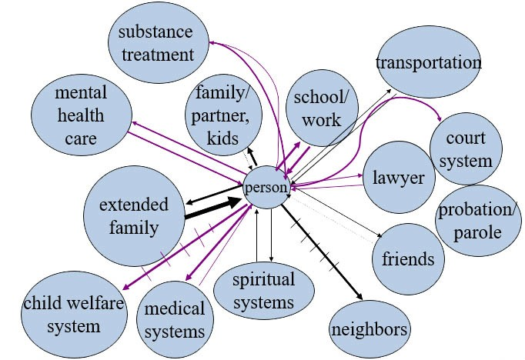
Eco-Map
(see Hartman, 1978)
www.cswe.org
Notes:
Presenter
2021-05-12 14:12:04
--------------------------------------------
This is where social workers often employ eco-mapping as a technique for exploring how individuals and family systems interface with other elements of the social, physical, and institutional environment in which they are embedded.

Slide 45

Embedded Systems
Family Systems Theory
Whole vs Parts
(see Begun, 2019; Begun, Hodge, & Early, 2016)
www.cswe.org
Notes:
Presenter
2021-05-12 14:12:04
--------------------------------------------
Second, a family system is greater than the sum of its parts—in other words, “family” has meaning to its members and we cannot understand a family system simply by knowing who is a member. This suggests that some decisions may reflect the needs of the family as a whole superceding the needs of any one individual.

Slide 46
Embedded Systems
Family Systems Theory
Whole vs Parts
Subsystems
(see Begun, 2019; Begun, Hodge, & Early, 2016)
www.cswe.org
Notes:
Presenter
2021-05-12 14:12:04
--------------------------------------------
Third, family systems operate through interacting subsystems—for example, couples, parent-child, sibling subsystems with their own rules of engagement that are affected by and affect the system as a whole. In many instances, families describe a member’s involvement with alcohol or other drugs as being a subsystem all its own—that the person has a relationship with the substances and that person-substance subsystem affects all the other subsystems and the system as a whole. Intervening with couples who engage in substance misuse together, whose entire relationship was founded within the context of substance use, can be challenging as the substance use is an integral aspect of their relationship. Helping one partner change threatens the balance of the entire relationship.

Slide 47

Embedded Systems
Family Systems Theory
Whole vs Parts
Subsystems Change in Systems
(see Begun, 2019; Begun, Hodge, & Early, 2016)
www.cswe.org
Notes:
Presenter
2021-05-12 14:12:05
--------------------------------------------
Fourth, family systems are dynamic over time—and change of any kind, positive or negative in nature, is costly to families in terms of energy and effort involved in adapting or adjusting to change. Because of the three principles already discussed, we know that change in any individual has a ripple effect throughout the entire family system. This helps explain why family systems are not always as receptive to a person’s recovery efforts as might be hoped for. They may, through a great deal of effort and pain, have learned to adapt to the person’s substance misuse and family disruptive behaviors., they may have achieved a new, hard won state of balance or homeostasis. It is a great deal to ask that they reengage with the change process and adapt once again to accept the changing person and support their recovery. Especially if they have been through that cycle a few times with the person. It is not that they perversely wish for that person to continue their substance misuse or substance use disorder, it is more that changing the family system in response to the individual’s changes is a costly effort.

Slide 48
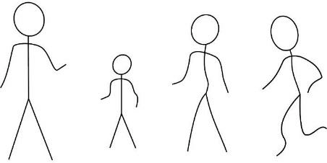
warmth
Preventive Parenting
control monitoring
(see Berkowitz & Begun, 2005; Jacob & Leonard, 1994)
www.cswe.org
Notes:
Presenter
2021-05-12 14:12:05
--------------------------------------------
Clearly, the family system represents a context for shaping substance-related expectancies, where substance use and misuse may be modeled by family members, and where substance use behavior may be reinforced or punished—in other words, as a context where the learning and cognitive expectancies principles previously discussed under the psychological domain are engaged. But, it is critical to recognize that family systems are also a context where abstinence or responsible alcohol or other substance use might be modeled, family members may discourage substance misuse through delivery of reinforcements and punishments, and negative expectancies about substance use may be fostered.
Family systems are a context for other protective factors that warrant attention in terms of preventive strategies—helping protect children, adolescents, and emerging adults from engaging in serious levels of substance misuse. Evidence concerning these preventive factors identified parental warmth as an important aspect of preventive parenting. These parents have warm relationships with their children, are able to provide emotional support and comfort, and act as a sounding-board for reflecting values and interpreting life experiences. In addition, preventive parenting involves a significant degree of parental monitoring—such that an adolescent knows that risky behavior they engage in will be found out by the parent—and because of the nature of their relationship, the young person cares about their parent’s opinion of them. They care about not disappointing their parent. These parents impose age-appropriate levels of behavioral control over their children and adolescent.

Slide 49

INFLUENCES & EFFECTS
➢Ecological Systems Theory
➢Family Systems Theory
➢Access/Physical Environments
➢Social Norms Theory
➢Social Justice
SOCIAL & PHYSICAL CONTEXTS
(see Begun, 2019; Begun, Bares, & Chartier, 2020; ONDCP, 2012)
www.cswe.org
Notes:
Presenter
2021-05-12 14:12:05
--------------------------------------------
Moving outside of social and emotional space, it is critical to acknowledge the influence of physical environments, including the degree to which these environments provide opportunity or easy access to alcohol and other substances. Access refers to the availability of preventive factors and accessibility of recovery support, as well.
No matter how much biological, psychological, and social forces are stacked in favor of a person developing a specific type of substance use disorder, this simply cannot happen if the person never encounters that type of substance. Unfortunately, in our society, it is impractical to remove all access. For example, there exists evidence that family and friends are the primary source of access to the pain medications used nonmedically. And, evidence that individuals often take their first drinks as children or adolescents in their family home.

Slide 50



(see Alaniz, 1998; Sudhinaraset, Wigglesworth, & Takeuchi, 2016)
www.cswe.org
Notes:
Presenter
2021-05-12 14:12:05
--------------------------------------------
Another example of physical environment influences relates to evidence that alcohol, tobacco, and vaping product advertising is often targeted to specific racial, ethnic, and age-group populations—it shows up on their neighborhood billboards, as neon signs in their local markets, and more recently, as targeted advertising in social media sites. As cannabis becomes legalized in more communities, a similar pattern may emerge.

Slide 51
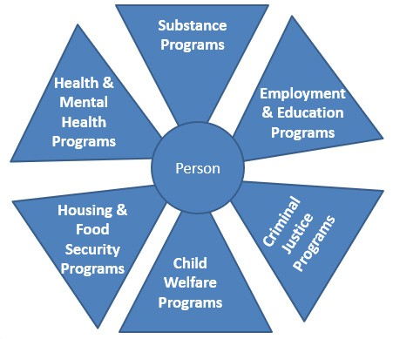
Access: Recovery Support Services
www.cswe.org
Notes:
Presenter
2021-05-12 14:12:05
--------------------------------------------
We not only are concerned with individuals’ access to substances, but to prevention and recovery support services. This leads to community and macro level considerations—looking at some of those larger spheres in the ecosystem. For example, there exists enthusiasm among scholars and practitioners for integrative and coordinated systems of care. This includes bringing evidence-supported screening and treatment services into primary health care and other natural settings like school and workplaces. It also includes expanding case management and wrap-around service models that coordinate systems of care concerned with substance misuse, mental health, physical health, housing and food security, economic and employment stability, child welfare, and criminal justice. The drug court model is just one example. Not only do social workers engage in case management for recovery support, they advocate for improved access to a range of integrated and coordinated recovery support services.

Slide 52

INFLUENCES & EFFECTS
➢Ecological Systems Theory
➢Family Systems Theory
➢Access/Physical Environments
➢Social Norms Theory
➢Social Justice
SOCIAL & PHYSICAL CONTEXTS
(see Begun, 2019; Begun, Bares, & Chartier, 2020)
www.cswe.org
Notes:
Presenter
2021-05-12 14:12:05
--------------------------------------------
An aspect of the social context relates to the nature of the substance-related social norms held by members of a person’s surrounding community and social networks. Social norms reflect a set of behavioral rules, guidelines, and expectations espoused by the social groups to which a person belongs. Family and peers are two locales where norms are expressed. Norms also are expressed in the media, from institutional resources such as what we learn in school or at work, in political campaigns, public health messaging, and social policy, among other sources. Substance-related norms often involve the expression of expectations concerning who uses what substances when, where, and how. They also involve expressions favoring or discouraging substance misuse and intoxication. Sociological theory concerning deviance norms is relevant to this discussion, as well.
A key point about social norms is that they have an impact on individuals’ behavioral choices. Another is that any individual is likely surrounding by competing messaging from the norms they encounter in different social groups or settings. What they hear from family, church, or school might not be the same as what they hear from peers and social media networks.

Slide 53




12th GRADERS
(MTF 2019)
vaping 25%
not vaping 75%
(see Miech et al, 2020)
www.cswe.org
Notes:
Presenter
2021-05-12 14:12:05
--------------------------------------------
Some prevention messaging have the possibility of backfiring if they emphasize that too many in a peer group use or misuse substances. Rather than seeing this as the problem, the message may be interpreted as substance use or misuse being common and, thus, normative—everyone else is doing it, so it is something they should do, too. For instance, data from the 2019 Monitoring the Future study showed that 25.5% of 12th graders had engaged in nicotine vaping during the past month. Rather than emphasizing that somewhat alarming 25.5%, we might want to emphasize instead that almost 75% didn’t—by not vaping, you are in the majority. The Monitoring the Future Study also provides a rich body of data about 8th, 10th, and 12th grade students’ attitudes, beliefs, and norms concerning a wide array of different substance use behaviors—perceive harmfulness of different drugs and use patterns, their own disapproval levels, perceived attitudes held by their parents and friends, and more. These data help inform prevention strategies with these age groups. More recent longitudinal data are also available concerning emerging adults who were previously surveyed as high school students.

Slide 54
INFLUENCES & EFFECTS
➢Ecological Systems Theory
➢Family Systems Theory
➢Access/Physical Environments
➢Social Norms Theory
➢Social Justice
SOCIAL & PHYSICAL CONTEXTS
(see Begun, 2019; Begun, Bares, & Chartier, 2020)
www.cswe.org
Notes:
Presenter
2021-05-12 14:12:05
--------------------------------------------
A significant aspect of the social context concerns stigma, disparities, and social justice issues related to substance misuse. These issues concern biases built into systems of care—for example, bias in screening and assessment protocols, referral patterns, gender and cultural competence of interventions, and other aspects of the system of care and recovery support. For example, if certain populations are not screened or referred for assessment, their needs will go undetected and the system will not provide expensive services. An instance of this source of disparities is failure to properly screen (and refer) individuals who are incarcerated—the criminal justice system will not provide substance-related services if the need is not recognized in the first place. Another social justice concern relates to service models, such as group treatment, and their accessibility to individuals who identify as LGBTQ+-- in many communities, LGBTQ+ individuals may feel very uncomfortable and unwelcome in group or even individual sessions.

Slide 55
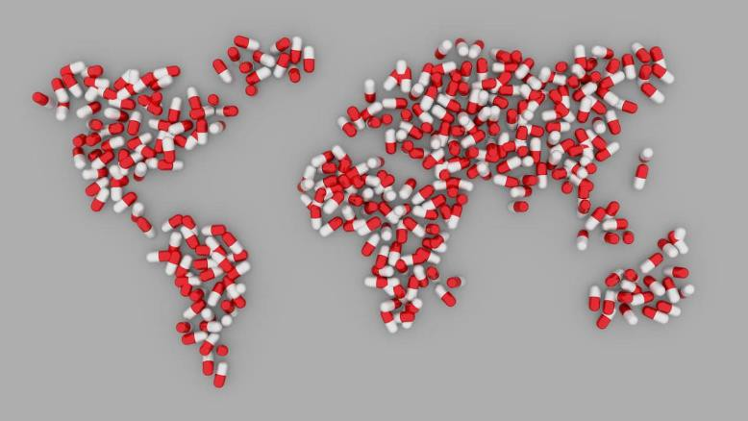
Global Forces
www.cswe.org
Notes:
Presenter
2021-05-12 14:12:05
--------------------------------------------
Social justice issues related to substance use and misuse extend to global systems and co-occurring issues. Consider, for instance, our nation’s relationships with countries where drugs are produced, trafficked, exported, and imported—whether sanctioned or not by the governments involved. Substance-related activities play a significant role in global economics and politics, particularly in our nation’s relations with Central and South American, Central European, and Asian countries. Not only do these forces and relations influence what happens with illicit substances in communities across the nation, they influence the availability, quality, and safety of prescription pharmaceutical drugs, as well—as evidenced by, among other things, specific shortages that occurred during the coronavirus pandemic, tremendous cost variability in similar drugs across different countries, and safety recalls of multiple kinds of medications due to their potential contamination.

Slide 56
PAST MONTH ALCOHOL/DRUG USE BY RACE/ETHNICITY (NSDUH, 2019)
1
56. |  |  |  |  |  |  |  |  |  |  |  |  | 25 9 25.8 |  |  |  |  |  |  |  |  |  |  |  |  | white Asian AI/AN |  |  |  |  |  |  |  |  |  |  |  |  | black/Af Am Hisp/Latino 2+ races
 |  | 49.5
 |  | 42.8 42.7
 |  |  |  | 37.6 |  |  |  | 32.1
 |  |  |  |  |  |  |  |  |  |  |  |  |  |  | 22. |  |  |  |  |  | 20
 |  |  |  |  |  |  |  |  |  |  |  |  |  |  |  |  | 13.4
 |  |  |  |  |  |  |  |  |  |  |  |  |  |  |  |  |  |  |  |  |  |  |  |  |  |  |  |  |  |  |  |  |  |  |  |  |  |  | 13.7
 |  |  |  |  |  |  |  |  |  |  |  |  |  |  |  |  |  |  |  |  |  |  |  |  |  |  |  |  |  |  |  |  |  |  |  |  |  |  |  |  |  |  | 4.4
 |  |  |  |  |  |  |  |  |  |  |  |  |  |  |  |  |  |  |  |  |  |  |  |  |  | 5.
 |  |  |  |  |  |  |  |  |  |  |  |  |  |  |  |  |  |  |  |  |  |  |  |  |  |  |  | 4
POPULATION %
7
24.2
.
19.7
12
9.5
12
6.9
8.9
3.6
2.
4.4
4
ALCOHOL USE
ALCOHOL BINGE
ALCOHOL HEAVY USE
CANNABIS
(see Begun, 2019; Bush-Baskette, 2004; SAMHSA, 2020)
www.cswe.org
Notes:
Presenter
2021-05-12 14:12:05
--------------------------------------------
Social justice aspects of substance-related activities intersect with issues of intimate partner and community violence, human trafficking, weapons trafficking, money laundering, and funding terrorist groups.
Social dominance models raise social justice concerns, as well. These models address intergroup inequalities being maintained through legitimizing myths that provide moral and intellectual justification for privilege and discrimination. Consider, for example, some of the prevailing stereotypes regarding alcohol and other drug misuse among different racial and ethnic groups—such as myths regarding alcohol and First Nation members (designated as AIAN in the NSDUH study) or regarding cannabis and Latino men. It is critically important for social workers to remain informed about and critically analyze the implications of current epidemiological evidence concerning disparities in substance use patterns and access to substance-related services. Additional social justice influences result from policy responses to substance-related issues. For example, racial inequities in incarceration rates are attributed to the nation’s historical War on Drugs. Significant disparities resulted, for instance, between incarceration of individuals arrested for powdered versus crack cocaine offenses, reflecting differences between more affluent white individuals’ use of powdered cocaine and less affluent black individuals’ use of crack cocaine, despite these groups using the same drug--cocaine. Incarceration trend data also led to the War on Drugs being labeled a War Against Black Women.
Additionally, the topic of stigma surrounding substance misuse and how stigma affects substance use behavior and recovery warrants an entire presentation on its own. On the flip side, a body of literature is emerging concerning the impact of exposure to racial microaggression on substance use among emerging adults.

Slide 57
INFLUENCES & EFFECTS
➢Ecological Systems Theory
➢Family Systems Theory
➢Access/Physical Environments
➢Social Norms Theory
➢Social Justice
SOCIAL & PHYSICAL CONTEXTS
(see Begun, 2019; Begun, Bares, & Chartier, 2020)
www.cswe.org
Notes:
Presenter
2021-05-12 14:12:05
--------------------------------------------
We introduced several types of social context and physical environment theories concerning substance use, misuse, use disorder, and recovery. As was true for the biological and psychological domains, these theories and models have significant implications for how we choose to intervene, and you are encouraged to delve more deeply into the models and their supporting evidence.

Slide 58

Theory Integration & Prevention
define the target
(see Begun, 1993, 2019)
www.cswe.org
Notes:
Presenter
2021-05-12 14:12:05
--------------------------------------------
Now that we have introduced a host of theories from the separate biological, psychological, and social context/physical environment domains, here is an opportunity to reintegrate them into a biopsychosocial perspective. This integrative conceptual framework has significant implications for planning prevention intervention strategies.
Step 1 in this conceptual framework involves carefully defining the target problem or concern—the topic of substance misuse is far too broad, as is preventing substance use disorder. It may be necessary to narrow the focus to a specific population, substance type, and behavior. For example, preventing vaping initiation among adolescents, or preventing heavy episodic drinking among college students, or preventing injury and death from intoxicated driving.

Slide 59
Theory Integration & Prevention
Vulnerability/Resilience
Risk/Protection
(see Begun, 1993, 2019)
www.cswe.org
Notes:
Presenter
2021-05-12 14:12:05
--------------------------------------------
Step 2 of the conceptual framework involves reviewing the evidence related to two key dimensions—the evidence related to vulnerability and resilience and evidence related to risk and protection. This framework makes important distinctions between vulnerability and risk—these terms are not used interchangeably. Nor are the terms resilience and protection.
Vulnerability and resilience are viewed as falling on a continuum of intrinsic factors, those factors that individuals bring to any situation. Evidence might refer to vulnerability related to a person’s genetic or other biological factors, such as early brain exposure. Vulnerability and resilience also refers to psychological factors—their past experiences, attitudes, values, what they have learned, or co-occurring challenges, all would be part of the vulnerability or resilience to the issue of concern. The elements in this continuum and whether they represent vulnerability or resilience factors are determined by the literature. The risk and protection continuum, on the other hand, refers to extrinsic factors—those social and physical environment factors that are relevant to the issue of concern. For example, this might relate to social norms, access to substances, access to recovery support, policy and enforcement practices, and social capital. Again, the nature of the risk and protection continuum is determined by the evidence. Note that the word “risk” here does not infer probability that a problem will emerge. It refers to a specific type of influencing factor.
An example helps reinforce the distinction between intrinsic vulnerability/resilience factors and extrinsic risk/protection factors. Consider social reinforcement of drinking behavior. Reinforcement that occurred in the past becomes a part of a person’s intrinsic learned experience—the person brings that past learning to any new situation. It is a vulnerability factor. On the other hand, currently drinking within a reinforcing context is an extrinsic situational risk factor—it is currently part of the environment.

Slide 60
 |  | VULNERABILITY
 |  | Low | High
RISK | Low | Probability I: Low | Probability II: Moderate
 | High | Probability III: Moderate | Probability IV: High
(see Begun, 1993, 2019)
www.cswe.org
Notes:
Presenter
2021-05-12 14:12:06
--------------------------------------------
The third step in this conceptual framework allows us to integrate evidence on the vulnerability/resilience continuum with evidence on the risk/protection continuum.
A note of caution here: because the evidence is based on group data and models, this framework is applied at the population level. We do not yet have the technological sophistication to apply it at the individual level. Let’s look at the prevention planning implications of this integration.

Slide 61
VULNERABILITY
Low
High
Probability I: Low
Probability II: Moderate
Low
RISK
Probability III: Moderate
Probability IV: High
High
(see Begun, 1993, 2019)
www.cswe.org
Notes:
Presenter
2021-05-12 14:12:06
--------------------------------------------
At the group or population level, we can generally predict the probability that the issue of concern will occur. This helps us direct scarce prevention resources where they will have the greatest likelihood of positive impact. It also helps us determine where to direct our preventive efforts—what kind of preventive strategies to employ.
In the first cell of our integrated grid the probability that the issue of concern will develop among individuals with low vulnerability situated in low risk environments is low, even without delivering any significant preventive effort. These individuals might also have intrinsic resilience and extrinsic protections. Thus, as long as we accurately identify vulnerability and risk as being low, with resilience and protection being high, we can direct our preventive intervention efforts elsewhere. Of course, this implies that neither continuum shifts in the wrong direction over time.

Slide 62
VULNERABILITY
Low
High
Probability I: Low
Probability II: Moderate
Low
RISK
Probability III: Moderate
Probability IV: High
High
(see Begun, 1993, 2019)
www.cswe.org
Notes:
Presenter
2021-05-12 14:12:06
--------------------------------------------
For the moment, let’s skip over to the last probability group, group 4. These are individuals who function in high risk environments lacking in strong protective factors, coming to these environments with high vulnerability and low resilience. For this group, the probability that the issue of concern will emerge is high. This is a group where utilizing a great deal of prevention resources could have a strong positive impact.
The aim of prevention could be either reducing vulnerability and enhancing resilience in order to move this population more towards group 3 where the probability of the issue emerging is more moderate, OR aiming to reduce environmental risk and enhance protection in order to move this population more towards group 2. Ideally, prevention efforts would be directed towards modifying both continuua and moving this population more towards group 1 where the probability of the problem emerging is low.

Slide 63
VULNERABILITY
Low
High
Probability I: Low
Probability II: Moderate
Low
RISK
Probability III: Moderate
Probability IV: High
High
(see Begun, 1993, 2019)
www.cswe.org
Notes:
Presenter
2021-05-12 14:12:06
--------------------------------------------
In between the group 1 and group 4 extremes we have two groups where the probability of the issue arising is moderate. Prevention efforts with group 2 might best be directed toward reducing their vulnerability and enhancing their resilience, thereby moving them more towards the low probability group 1. As long as this group remains in a low risk environment, their probability of developing the issue of concern is moderate—so prevention efforts might also be directed towards maintaining that low risk environment and shoring them up with environmental protections. This will help prevent their slipping into the high probability group 4. Likewise, prevention efforts with group 3 might best be directed toward reducing the risks in their environment and boosting their protections, with the aim of moving them more toward the low probability group 1. And, as long as their vulnerability remains low and resilience high, they are not likely to slip into the high probability group 4. Thus, some of our efforts might be aimed at ensuring they do not develop new vulnerabilities or lose resilience, too.

Slide 64
 |  | VULNERABILITY
 |  | Low | High
RISK | Low | Probability I: Low | Probability II: Moderate
 | High | Probability III: Moderate | Probability IV: High
(see Begun, 1993, 2019)
www.cswe.org
Notes:
Presenter
2021-05-12 14:12:06
--------------------------------------------
Probably the most important take-home lesson of this integrative biopsychosocial framework regarding vulnerability, resilience, risk, and protective factors is that no one single type of preventive intervention is likely to be sufficient. We need to tackle these substance-related issues of concern from a position of complexity based on what the various sources of evidence about biological, psychological, and social context and physical environments tell us matters. The second most important message is that while we need to be attentive to the vulnerabilities and risks related to a specific issue of concern, we also have the benefit of a strengths perspective where we can explore resilience and protection, as well.

Slide 65
Generalized or Specific?
alcohol cannabis tobacco opioid
all one and the same
www.cswe.org
Notes:
Presenter
2021-05-12 14:12:06
--------------------------------------------
One final theoretical principle to consider is the extent to which a particular theory or model covers the phenomena of substance misuse and substance use disorders in a generalized way or is more specific, for example—does it apply regardless of which substances are involved, treating them as all one and the same, or only to a specific substance type.

Slide 66
Generalized or Specific?
alcohol cannabis tobacco opioid
cannabis
alcohol
each uniquely different
tobacco
opioid
all one and the same
www.cswe.org
Notes:
Presenter
2021-05-12 14:12:06
--------------------------------------------
On the other hand, it is possible that the underlying processes differ for different substances, requiring unique and different theories and models depending on which substances are involved.

Slide 67
Generalized or Specific?
alcohol
opioid
cannabis
tobacco
www.cswe.org
Notes:
Presenter
2021-05-12 14:12:06
--------------------------------------------
The evidence suggests that neither and both are correct.
There exist some similarities and areas of overlap across types of substances, but each type of substance has some unique factors, as well. This is a very different picture from where there was 100% overlap from where there was zero overlap.
In this final picture, there might be a very small area in which all overlap, there might be areas where some overlap occurs between certain types but not all types of substances, accompanies by areas of uniqueness related to each type of substance, too. This certainly presents a very complex model and helps us understand why there is no such thing as one umbrella theory or solution!
For instance, investigators exploring the question of a genetic basis to substance use disorders in general have asked “is there such a thing as an ‘addiction’ gene, one that is relevant regardless of the type of substances involved?” The conclusion is basically, no—there is no one single gene pulling for or protecting from substance use disorder across all substance types. However, there are some areas of overlap, for instance in the genetic underpinnings to alcohol and opioid use disorders. It is less clear whether the psychological or social and physical context theories are appropriately applied in a more general manner or need to be applied more specifically—again, most likely, there are areas of overlap and areas of uniqueness involved.

Slide 68

Wrap-up
•Theory Informs Solutions
•Biopsychosocial Perspective
•Vulnerability/Resilience, Risk/Protection Factors Framework
•Circularity of Influence
•Generalized vs Specific Theory
Notes:
Presenter
2021-05-12 14:12:06
--------------------------------------------
So, the first key point from this presentation concerning multiple theories and models related to substance misuse is that our wide array of theories offers an array of solutions and opportunities for intervening! These include efforts to reduce the harms associated with substance use—what harm reduction is all about.
The second is that the various theories can be systematically organized by adopting the biopsychosocial perspective central to our social work profession and supported by many other disciplines. In this context, you were briefly introduced to quite a few biological, psychological, and social context physical environment theories and models concerning substance use initiation, substance misuse, substance use disorders, and recovery within this biopsychosocial perspective. Then, you were introduced to an integrative conceptual framework related to evidence concerning vulnerability, resilience, risk, and protective factors. The concept of circularity of influence was introduced as was a discussion of applying generalized and specific perspectives to the different types of substances involved.
Hopefully, this presentation has provided you with a conceptual system for pursuing theories and models in greater depth to better inform your intervention efforts. Thank you for your attention and consideration throughout this presentation.

Slide 69
References
Alaniz, M.L. (1998). Alcohol availability and targeted advertising in racial/ethnic minority communities. Alcohol Health and Research World, 22(4), 286-289.
Bares, C.B., & Chartier, K.G. (2020). The role of genes and environment in shaping substance misuse. In A.L. Begun & M. M. Murray, (Eds.), The Routledge handbook of social work and addictive behaviors, (78-94). NY: Routledge.
Begun, A.L. (1993). Human behavior and the social environment: The vulnerability, risk, and resilience model. Journal of Social Work Education, 29, 26-35.
Begun, A.L. (2019). Theories and biological basis of substance misuse. Open Educational Resource. Retrieved from https://ohiostate.pressbooks.pub/substancemisusepart1/ and
https://ohiostate.pressbooks.pub/substancemisusepart2/
Begun, A.L. (2020a). Introduction to psychoactive substances. In A.L. Begun & M. M. Murray, (Eds.), The Routledge handbook of social work and addictive behaviors, (18-38). NY: Routledge.
Begun, A.L. (2020b). Psychological models of addictive behavior. In A.L. Begun & M. M. Murray, (Eds.), The Routledge handbook of social work and addictive behaviors, (95-109). NY: Routledge.
Berkowitz, M.W., & Begun, A.L. (2005). Designing prevention programs: The developmental perspective. Handbook of drug abuse prevention: Theory, science, and practice,
(pp. 327-348). MA: Kluwer Academic/Plenum Publishers.
69
www.cswe.org

Slide 70
Begun, A.L., & Brown, S. (2014). Neurobiology of substance use disorders and implications for treatment. In S.L.A. Straussner, (Ed.), Clinical work with substance abusing clients, 3rd edition, (pp. 39-66). NY: Guilford Press.
Begun, A.L., Clapp, J., & The Alcohol Misuse Grand Challenge Collective. (2015). Reducing and preventing alcohol misuse and its consequences: A Grand Challenge for social work. Cleveland, OH: American Academy of Social Work & Social Welfare. Retrieved from https://grandchallengesforsocialwork.org/wp-content/uploads/2015/12/WP14-with- cover.pdf
Begun, A.L., Hodge, A.I., & Early, T.J. (2016). A family systems perspective in prisoner reentry. In S. Stojkovic, (Ed.), Prisoner reentry, (pp.85-144) . NY: Palgrave Macmillan.
Brooks, P.J., Enoch, M.A., Goldman, D., Li, T.K., & Yokoyama, A. (2009). The alcohol flushing response: An unrecognized risk factor for esophageal cancer from alcohol consumption. Plos Med, 6(3), e100050. Retrieved from https://www.ncbi.nlm.nih.gov/pmc/articles/PMC2659709/
Bush-Baskette, S.R. (2013). The War on Drugs as a war against black women. In M. Chesney- Lind & L. Pasko, (Eds.), Girls, women, and crime: Selected readings (pp. 175-184). Thousand Oaks, CA: Sage.
Fehrman, E., Egan, V., Gorban, A.N., Levesley, J., Mirkes, E.M., & Muhammad, A.K. (2019). Personality traits and drug consumption: A story told by data. Cham, Switzerland: Springer Nature.
Grant, B. F., & Dawson, D.A. (1998). Age of onset of drug use and its association with DSM- IV drug abuse and dependence: Results from the National Longitudinal Alcohol Epidemiologic Survey. Journal of Substance Abuse, 10, 163-173.
70
www.cswe.org

Slide 71
Hartman, A. (1978). Diagrammatic assessment of family relationships. Social Casework, 59(8), 465-476.
Jacob, T., & Leonard, K.E. (1994). Family and peer influences in the development of adolescent substance abuse. In R. Zucker, G. Boyd, & J. Howard, (Eds.), The development of alcohol problems: Exploring the biopsychological matrix of risk, (pp. 123-156). NIAAA Research Monograph No. 26, USDHHS, NIH Publication No. 94-3495.
Rockville, MD: National Institute of Alcohol Abuse and Alcoholism.
Jester, J.M., Wong, M.M., Cranford, J.A., Buu, A., Fitzgerald, H.E., & Zucker, R.A. (2015). Alcohol expectancies in childhood: Change with the onset of drinking and ability to predict adolescent drunkenness and binge drinking. Addiction, 110(1), 71-79.
Koob, G.F. (n.d.) The potential of neuroscience to inform treatment. NIAAA Focus on: Neuroscience and treatment. Retrieved from https://pubs.niaaa.nih.gov/publications/arh40/144-151.htm
Koob, G.F., & Volkow, N.D. (2010). Neurocircuitry of addiction. Neuropharmacology, 35, 217-238.
Kristjansson, S.D., Agrawal, A., Lynskey, M.T., & Chassin, L.A. (2012). Marijuana expectancies and relationships with adolescent and adult marijuana use. Drug and Alcohol Dependence, 126, 102-110.
Maimaris, W., & McCambridge, J. (2014). Age of first drinking and adult alcohol problems: Systematic review of prospective cohort studies. Journal of Epidemiology and Community Health, 68(3), 268-274.
McCrady, B. (2006) Family and other close relationships. In W.R. Miller & K.M. Carroll, (Eds.), Rethinking Substance Abuse: What the Science Shows and What We Should Do About It, (pp.166-181). NY: Guilford.
www.cswe.org

Slide 72
McCrady, B. (2006) Family and other close relationships. In W.R. Miller & K.M. Carroll, (Eds.), Rethinking Substance Abuse: What the Science Shows and What We Should Do About It, (pp.166- 181). NY: Guilford.
Miech, R.A., Johnston, L.D., O’Malley, P.M., Bachman, J.G., Schulenberg, J.E., & Patrick, M.E. (2020). Monitoring the Future: National survey results on drug use, 1975-2019. Volume 1— Secondary school students. Ann Arbor: Institute for Social Research, The University of Michigan. Retrieved from http://www.monitoringthefuture.org/pubs/monographs/mtf- vol1_2019.pdf
National Institute on Drug Abuse (NIDA). (2018). Drugs, brains, and behavior: The science of addiction. Retrieved from https://www.drugabuse.gov/publications/drugs-brains-behavior- science-addiction/preface
Office of National Drug Control Policy (ONDCP). (2012). National survey shows friends and family are primary source of abused painkillers. Retrieved from https://obamawhitehouse.archives.gov/realitycheck/ondcp/news-releases-remarks/national- survey-shows-friends-and-family-are-primary-sources-of-abused-painkillers
Prochask, J.O., DiClemente, C.C., & Norcross, J.C. (1992). In search of how people change: Applications to addictive behaviors. American Psychologist, 47(9), 1102-1114.
Substance Abuse and Mental Health Services Administration (SAMHSA). (2020). 2019 NSDUH detailed tables. Retrieved from https://www.samhsa.gov/data/report/2019-nsduh-detailed- tables
Sudhinaraset, M., Wigglesworth, C., & Takeuchi, D. (2016). Social and cultural contexts of alcohol use: Influences in a social-ecological framework. Alcohol Research, 38(1), 35-45.
Vakharia, S.P., & Little, J. (2020). Policy reforms to reduce harms associated with substance misuse. In A.L. Begun & M. M. Murray, (Eds.), The Routledge handbook of social work and addictive behaviors, (pp. 482-496). NY: Routledge.
White, A.M. & Koob, G.F. (2020). Overview of addiction and the brain. In A.L. Begun & M. M. Murray, (Eds.), The Routledge handbook of social work and addictive behaviors, (pp. 58-77). NY: Routledge.
www.cswe.org

Slide 73
Credits
Unless otherwise noted, images were created by Audrey Begun for this presentation or retrieved (and possibly edited) from Creative Commons license on Pixabay.com.
Grizzly bear image © Audrey Begun
The inkblot image retrieved from 123RF is copyrighted to © Aлeнa Mapyceвa
Orality image edited from image by 愚木混株 Cdd20 on Pixabay
www.cswe.org

Slide 74


Thank you!

